Slide 1
CITMA Seminar - Online infringement Tackling infringement on social media Becky Knott, Potter Clarkson
www.citma.org.uk

Slide 2
Tackling infringement on social media Becky Knott, Potter Clarkson

Slide 3
Agenda
1
The procedure for social media takedowns.
2
Practical tips and tricks.
3
Unjustified threats and takedowns.
4
Conclusion and takeaways.

Slide 4
Takedown procedure

Slide 5
What are we tackling today?

Slide 6
Taking it back to the policy…
Facebook’s ‘Terms of Service’:
You may not use our Products to do or share anything…
That infringes or violates someone else's rights, including their intellectual property rights (such as by infringing another's copyright or trademark, or distributing or selling counterfeit or pirated goods), unless an exception or limitation applies under applicable law.
Instagram’s ‘Terms of Use’:
You can’t…do anything that violates someone else's rights, including intellectual property rights (e.g., copyright infringement, trademark infringement, counterfeit, or pirated goods).
You may use someone else's works under exceptions or limitations to copyright and related rights under applicable law. You represent you own or have obtained all necessary rights to the content you post or share.
Twitter’s ‘Terms of Service’:
We reserve the right to remove Content that violates the User Agreement, including for example, copyright or trademark violations or other intellectual property misappropriation, impersonation, unlawful conduct, or harassment.

Slide 7
Taking it back to the policy…
Telegram’s ‘Terms of Service’:
Does not contain anything about Intellectual Property…
TikTok’s ‘Intellectual Property Policy’:
TikTok respects the intellectual property rights of others, and we expect you to do the same. TikTok’s Terms of Service and Community Guidelines do not allow posting, sharing, or sending any content that violates or infringes someone else’s copyrights, trademarks or other intellectual property rights.
Great BUT:
Policy, not the law.
Great deal of latitude for interpretation.
Are social media platforms ‘judge, jury, and executioner’?
Seemingly little guidance available for those reviewing takedown requests.

Slide 8
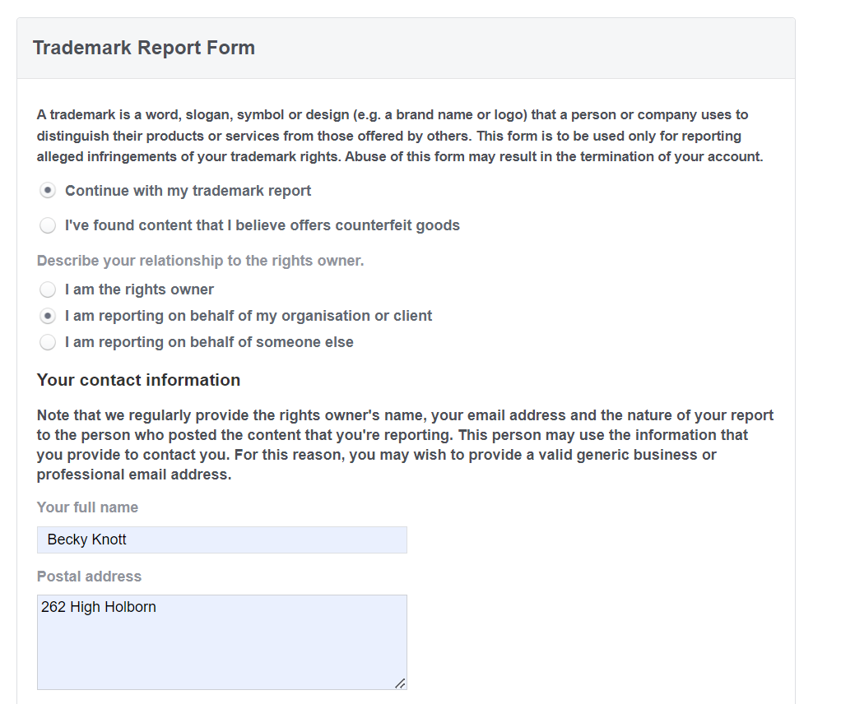
Facebook (and Instagram)

Slide 9
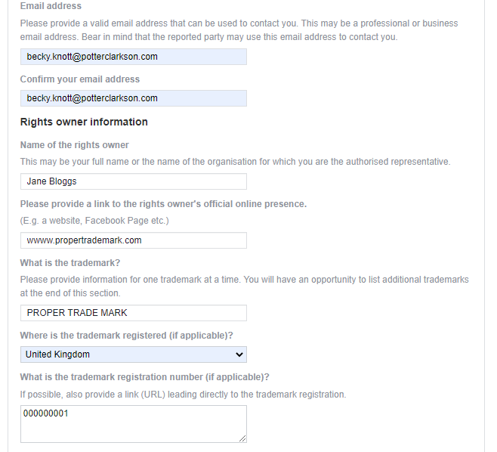
Facebook (and Instagram)

Slide 10
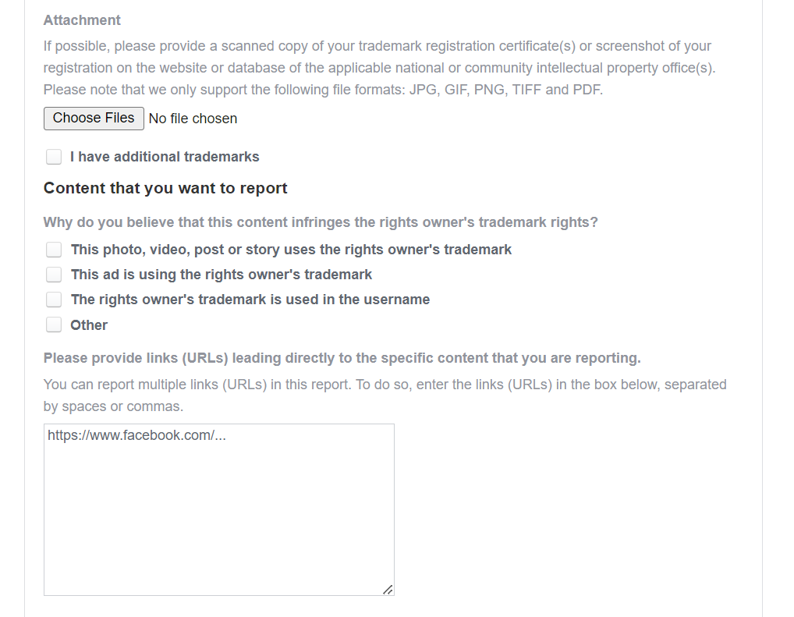
Facebook (and Instagram)

Slide 11
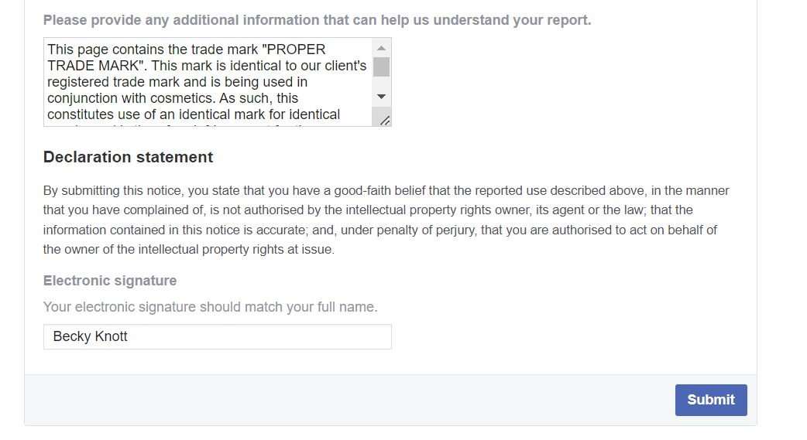
Facebook (and Instagram)

Slide 12
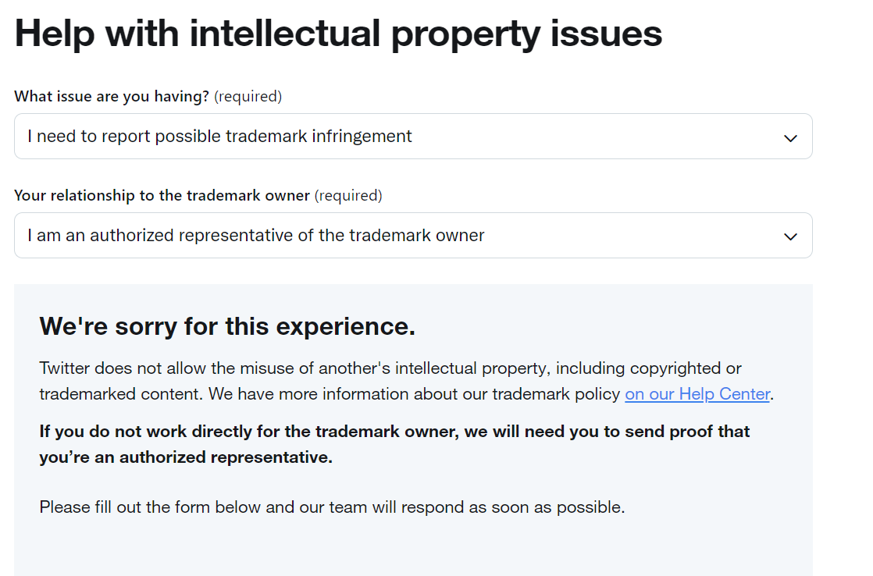
Twitter

Slide 13
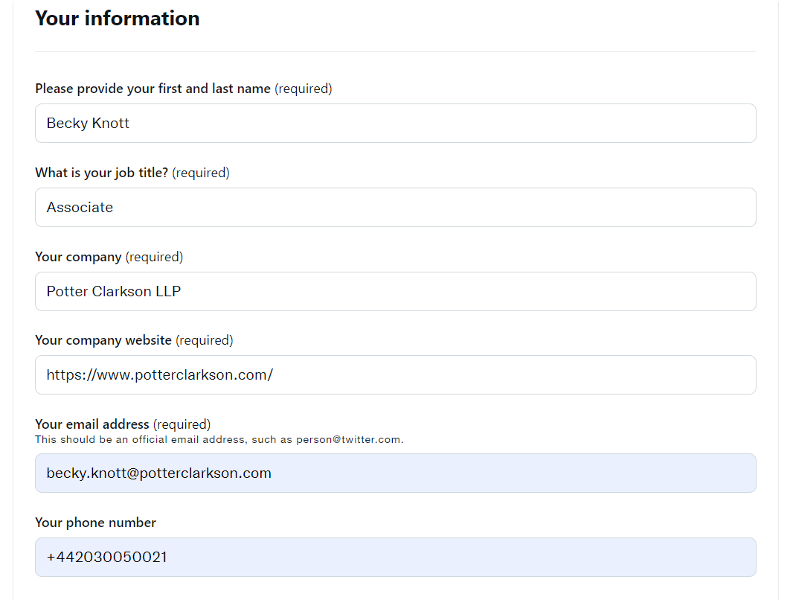
Twitter

Slide 14
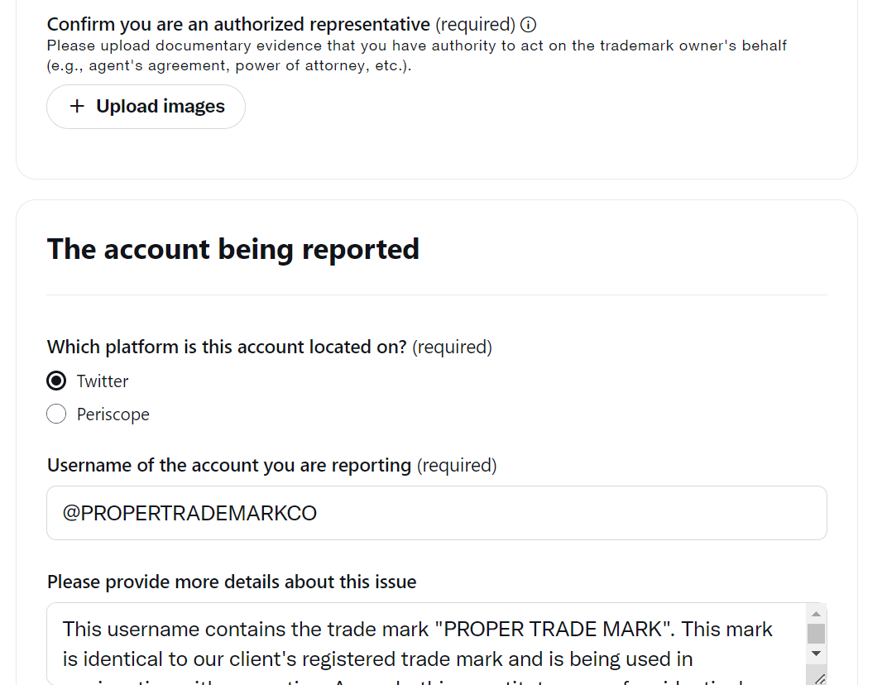
Twitter

Slide 15
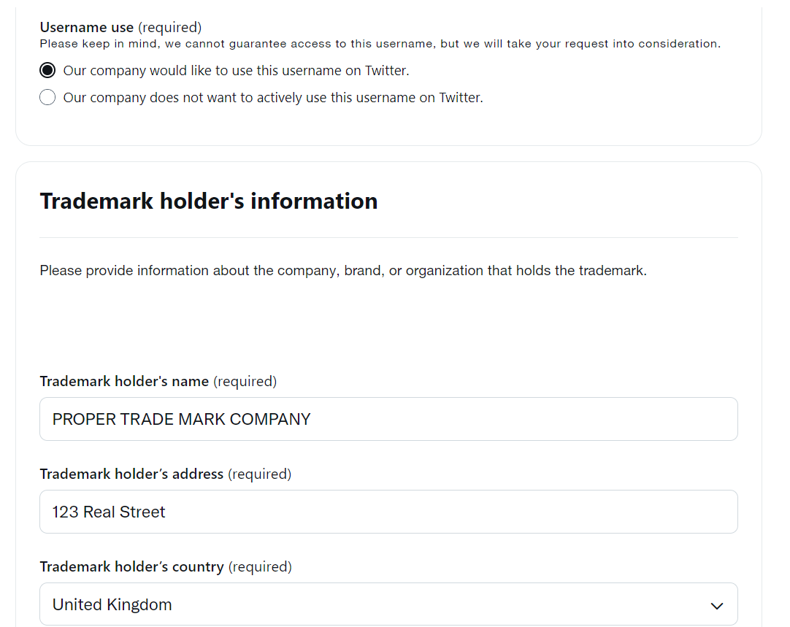
Twitter

Slide 16
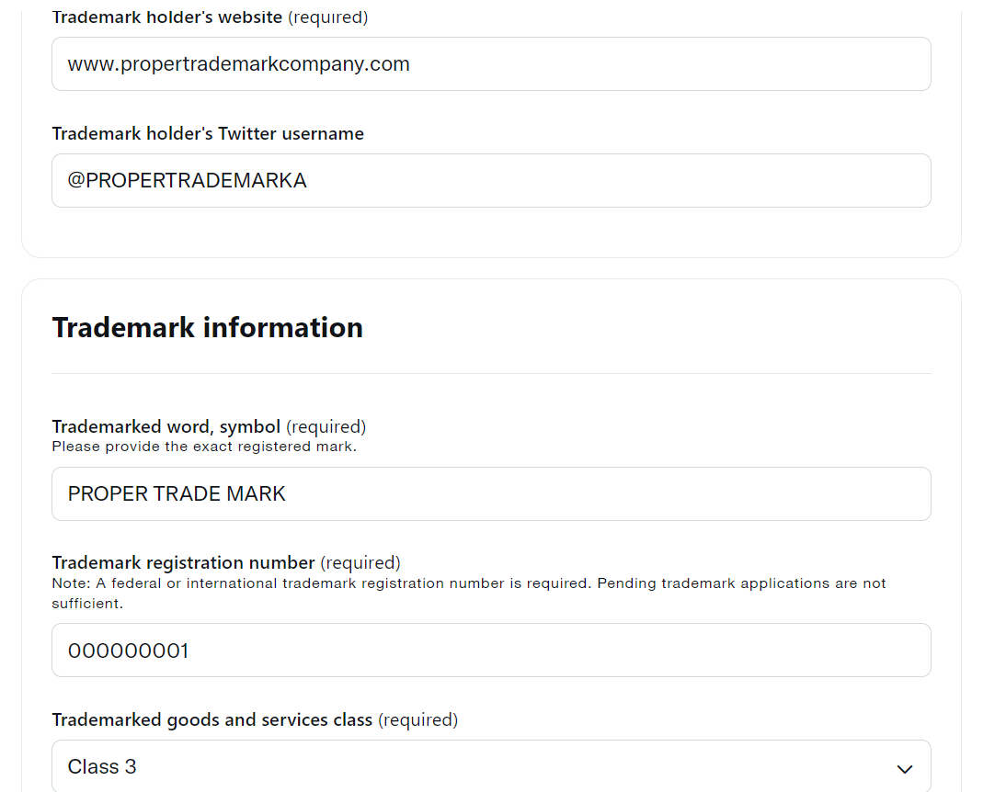
Twitter

Slide 17
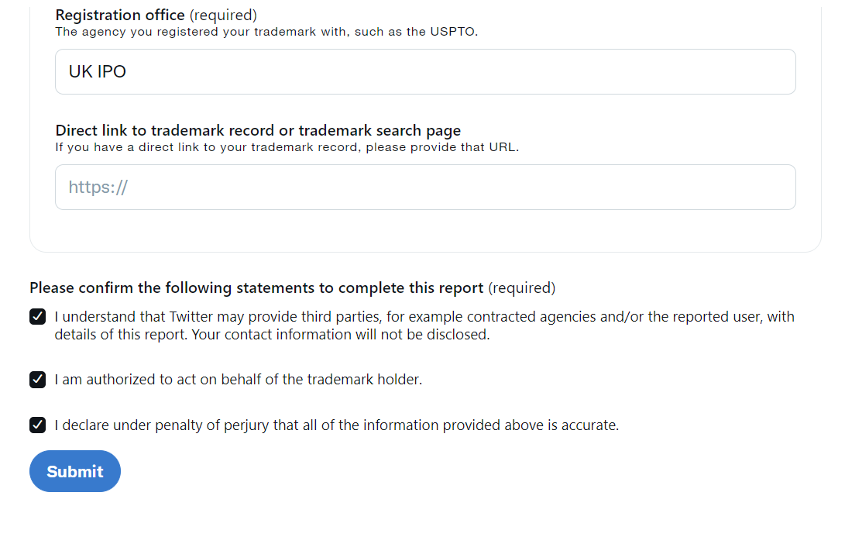
Twitter

Slide 18
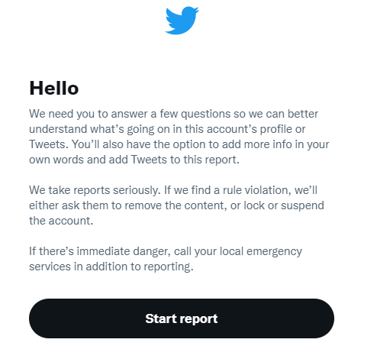
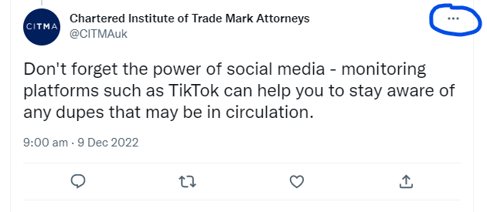
Twitter

Slide 19
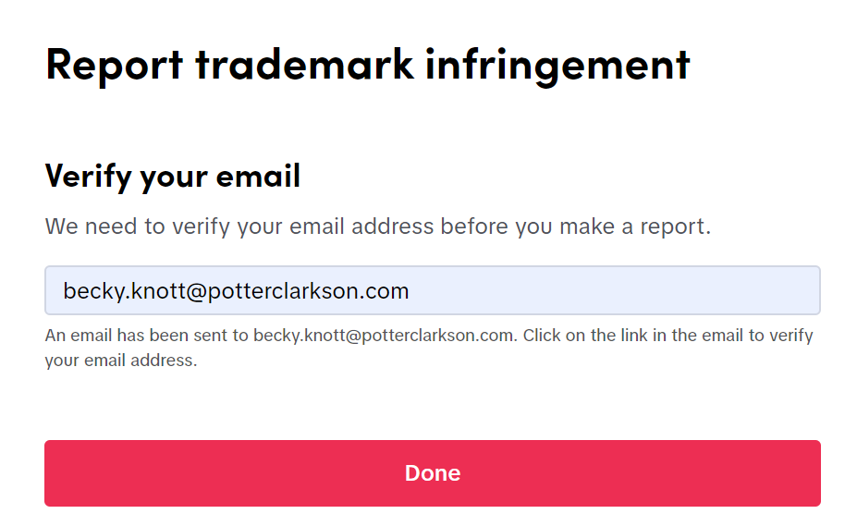
TikTok

Slide 20
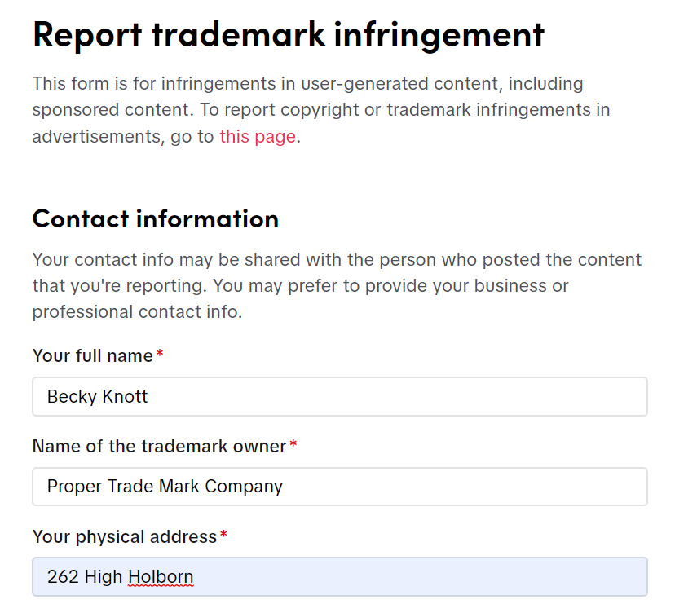
TikTok

Slide 21
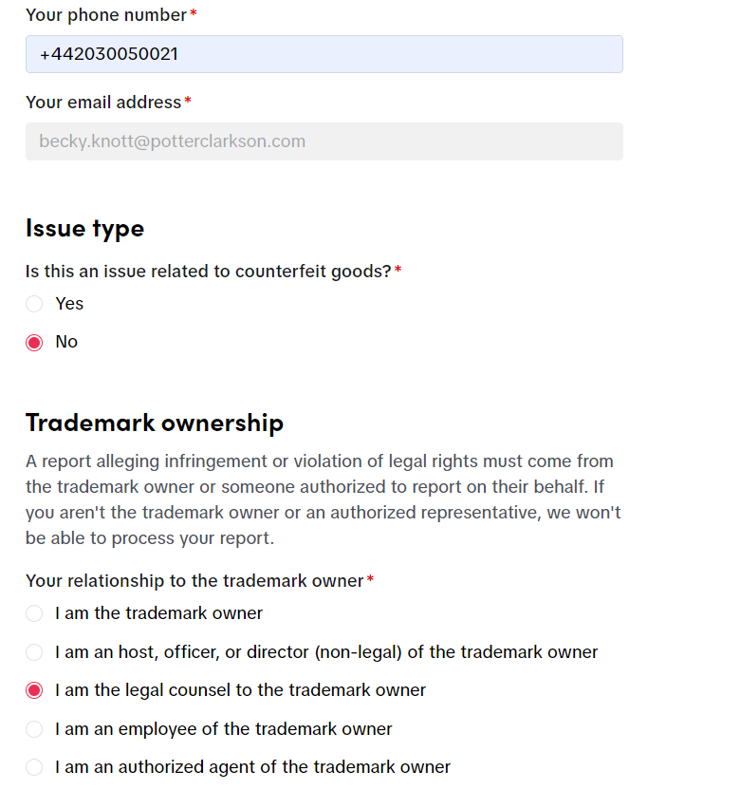
TikTok

Slide 22
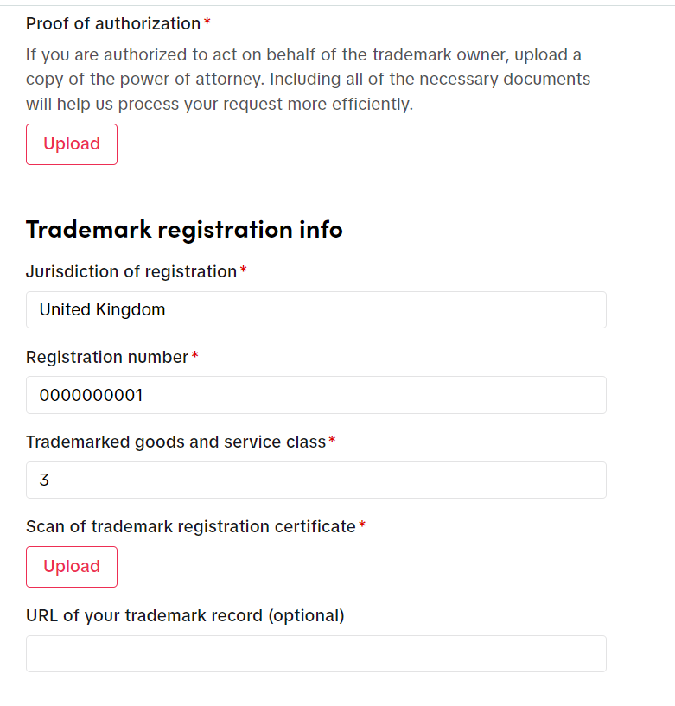
TikTok

Slide 23
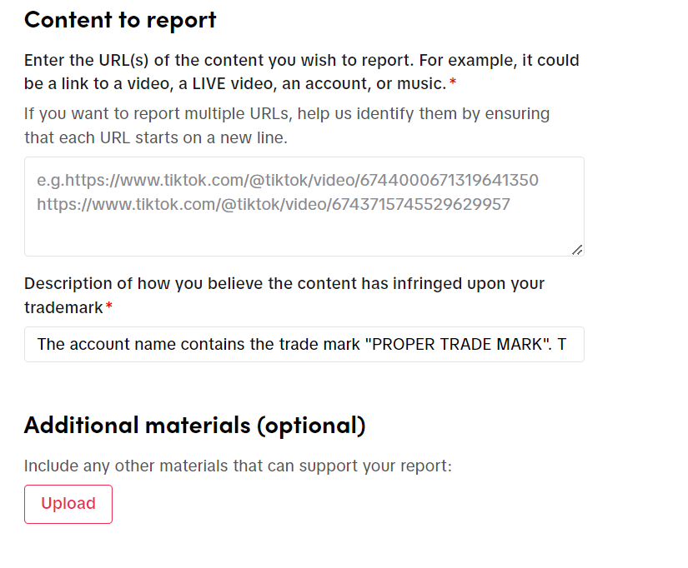
TikTok

Slide 24
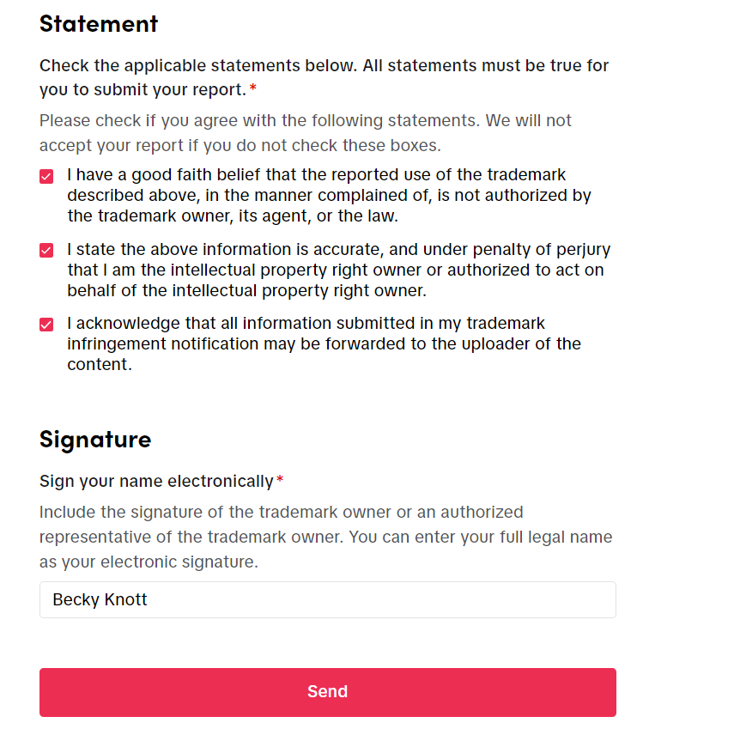
TikTok

Slide 25
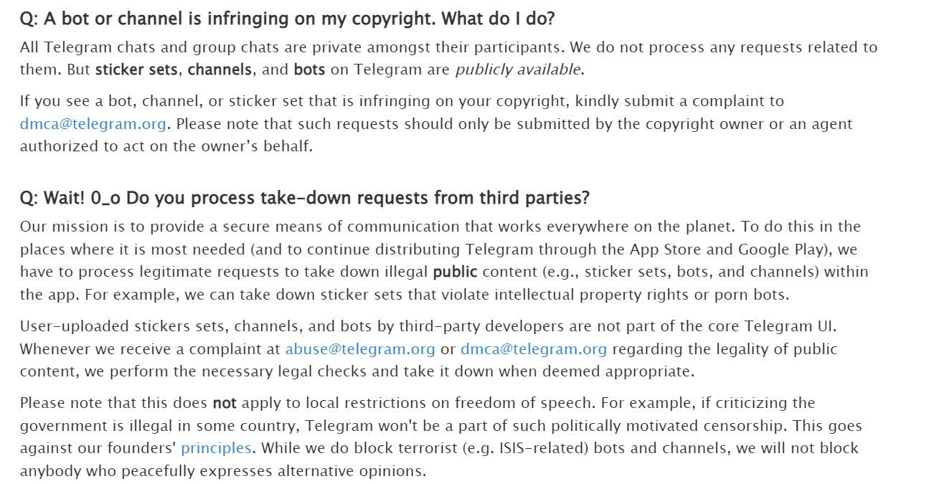
Telegram

Slide 26
Practical tips and tricks

Slide 27
Problems
Speed varies between platforms.
Facebook, very quick vs Telegram, very slow.
Rigid assessments.
Automated responses. Unresponsive.
Lack of consistency.
Not always suitable for an unusual case.
No repeat offender policy (possible exception for Twitter).

Slide 28
Solutions!
Get creative!
Keep good records and create a policy.
Don’t bulk file – separate links out.
Review content holistically.
Make use of UDRP where possible.
Consider escalation.
If all else fails, try and try again (although beware threats).

Slide 29
Unjustified threats

Slide 30
(1) A communication contains a “threat of infringement proceedings” if a reasonable person in the position of a recipient would understand from the communication that— (a) a registered trade mark exists, and (b) a person intends to bring proceedings (whether in a court in the United Kingdom or elsewhere) against another person for infringement of the registered trade mark by— (i) an act done in the United Kingdom, or (ii) an act which, if done, would be done in the United Kingdom.
Section 21, UK Trade Marks Act 1994

Slide 31
Shenzhen Carku Technology Co v The Noco Company [2022] EWHC 2034 (Pat) §§ 207 – 258 Judgment of 04 August 2022.
Patent case concerning battery-powered car jump starters.
Dispute arose over Noco’s use of Amazon takedowns.
Several of Carku’s products were delisted.
Carku sought to revoke Noco’s patent and alleged that Noco’s communications to Amazon were actionable threats.
Noco defended the patent’s validity and counterclaimed for infringement.
Patent found to be invalid for lack of inventive step and Noco therefore liable for making unjustified threats.

Slide 32
Shenzhen Carku Technology Co v The Noco Company [2022] EWHC 2034 (Pat) §§ 207 – 258 Judgment of 04 August 2022.
§ 238: “the notifications must be understood according to how they would have been perceived by the reasonable person in Amazon’s position”.
§ 248: “it is sufficient that the reasonable person in the position of the recipient of the threat understands from the communication that proceedings are intended against “another person”.”
§ 236: position of third parties: email from Noco quoted which made it clear that they “continue to file” claims against alleged infringers.
§ 253: Amazon, does not delist automatically, without assessment.
§ 254: Amazon could not know that Noco would not sue it: lawyers clearly involved and Noco sent claim charts.

Slide 33
For the reasons given above, this is a finding based on the facts before me. It is not a general finding about online markets. Carku’s floodgates argument does not arise.
Mr Justice Meade
Carku v Noco [2022] EWHC 2034, § 258

Slide 34
Conclusion and takeaways

Slide 35
Monitor and act quickly.
Tailor your approach.
Strengthen your portfolio.
Social media registration.
Be mindful of threats.

Slide 36
Thank you! Any Questions? becky.knott@potterclarkson.com 020 3005 0021

