Slide 1
SkyKick
What Does it Mean in Practice?
Emmy Hunt and Edwina FitzHugh
CITMA Autumn Conference
17 October 2019

Slide 2
INTRODUCTION
Why is this case so important?
Advances our understanding of bad faith and invalidity
What should the consequences of this be?
What shapes our understanding to date?
Key case law – Fidelity, MONOPOLY, KOTON
Policy considerations
Possible impact on Registry practice and our day-to-day work
Filing strategies
Review of existing portfolios

Slide 3
SKY v SKYKICK
Whips
Fuel additives
Gladstone bags
Computer software
Are some terms invalid for lack of clarity and precision?
Is “computer software” one of these terms?
Were Sky’s applications made in bad faith?
If so, are they wholly invalid or only partly invalid?
Sky Plc & Ors v Skykick UK Ltd & Anor [2018] EWHC 155 (Ch), 6 February 2018

Slide 4
FIL v FIDELIS
FIDELITY
Insurance services
Investment services
Financial services
FIDELIS
Descriptive for fidelity insurance
Not identical nor sufficiently similar to insurance activities
Invalid for lack of clarity and precision
FIL Ltd & Anor v Fidelis Underwriting Ld & Ors [2018] EWHC 1097 (Pat), 11 May 2018

Slide 5
KOTON
Article 59 EUTMR:
An EU trade mark shall be declared invalid on application to the Office…
…(b) where the applicant was acting in bad faith when he filed the application
for the trade mark.
Applicant’s Mark (classes 25, 35 and 39) | Earlier mark (classes 18, 25 and 35)
Koton Mağazacilik Tekstil Sanayi ve Ticaret AŞ v EUIPO and Joaquín Nadal Esteban – C-104/18P, 12 September 2019

Slide 6
MONOPOLY
Registered in 2015 in classes 9, 16, 28, 41
CD – “evergreening” is common practice and not bad faith
BoA – Oral hearing and cross examination; in these circumstances, it is bad faith
Kreativni Dogadaji v Hasbro, R 1849/2017-2, 22 July 2019

Slide 7
POLICY CONSIDERATIONS
Making a fairer playing field
The cost of vagueness – why minimising clutter is important
So, what should the scope of invalidity be?

Slide 8
WHAT CHANGES MIGHT WE SEE?
Different examination of new applications
Reform of Nice Classification
Proof of intention to use
Post registration limitations

Slide 9
A NEW “BEST PRACTICE”?
What is too broad? Can we still include “computer software” and “financial services”?
File and re-file carefully
Register a “key” mark (core goods and services) and “sub” mark (broad goods and services)?
Prepare a “Proof of use package”?

Slide 10
SPECIFICATION LENGTH
Average length of EUTM specification = 60-100 terms (8 Aug 2019)
Sky’s specification: some cover 8,000 words
Longest EUTM specification = HADEAN owned by Hadean Supercomputing Ltd
EU Registration HADEAN | US Registration HADEAN
11 Classes | 3 Classes
26,000 goods and services | 42 goods and services
118,000 words | 235 words
Average length of a novel = 90,000 words

Slide 11
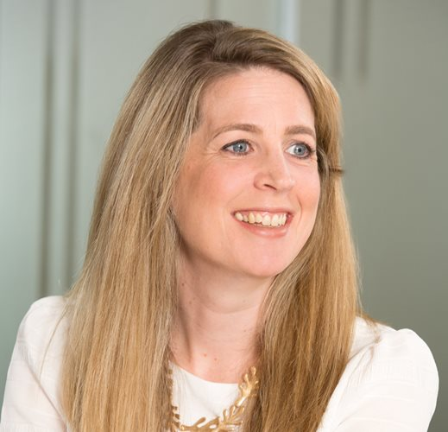
Emmy Hunt
emmy.hunt@potterclarkson.com
Edwina FitzHugh
edwina.fitzhugh@potterclarkson.com

Slide 12
Potter Clarkson LLP
www.potterclarkson.com
Nottingham Potter Clarkson The Belgrave Centre, Talbot Street, Nottingham, UK, NG1 5GG T: +44 (0)115 955 2211 | London Potter Clarkson Halton House, 20 - 23 Holborn, London, UK, EC1N 2JD T: +44 (0)20 300 500 10 | Munich Potter Clarkson Bavariaring 26 D-80336, Munich, Germany T: +49 89 255 52930 | Copenhagen Potter Clarkson Havnegade 39 1058, Copenhagen, Denmark T: +45 33 29 99 82 | Stockholm Potter Clarkson 7A Centralen Vasagatan 7 111 20 Stockholm, Sweden T: +46 812 21 77 77 | Lund Potter Clarkson The Spark, Room 12333 Medicon Village Scheeletorget 1, Lund Sweden T: +44 (0)115 955 2211

