Slide 1

The Role of a Chartered Trade Mark Attorney
Mark Bearfoot MCITMA
Senior Legal Director, IP & Brand Protection
Tommy Hilfiger Global & PVH Europe
markbearfoot@pvh.com

Slide 2
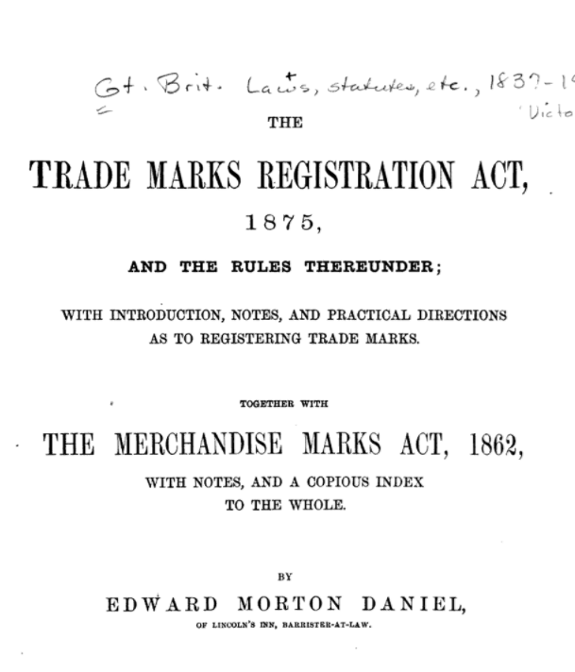

History

Slide 3
History

Slide 4
UK Legal Profession Landscape
Legal Services Act 2007 – Authorised / Regulated Persons (‘Lawyers’):
Barristers
Law Costs Draftsman
Legal Executives
Licensed Conveyancers
Notaries Public
Patent Attorneys
Solicitors
Trade Mark Attorneys.

Slide 5
Chartered Trade Mark Attorney
Legal Services Act 2007 - Regulated Person who may carry out certain reserved legal activities:
  Those reserved legal activities are—
    the exercise of a right of audience;
    the conduct of litigation;
    reserved instrument activities - i.e. 'any act in connection with the registration of a trade mark, or any procedure relating to a registered trade mark’;
    the administration of oaths.
    Trade Marks Act 1994 - Privilege for Communications

Slide 6
Qualification – Entry onto the Register
Successfully complete one of the IPReg-accredited foundation courses and the advanced level (professional practice skills) course;
IPReg rules: 2 + years of supervised training overseen by a Chartered Trade Mark Attorney or another suitably qualified person;
Training diary not mandatory but recommended;
Statutory declaration including details of supervised trainer(s);
Once on Register, join CITMA as an Ordinary member to become Chartered

Slide 7
Qualification – Foundation Courses
Bournemouth University
Postgraduate Certificate: Intellectual Property Law & Practice
This programme starts in January and runs for five months. Delivered over three weekends, supported by online distance learning.
Brunel University London
Postgraduate Certificate: Intellectual Property Certificate
This programme starts in September. Delivered Wednesday afternoons over eight months.
Queen Mary University of London
Postgraduate Certificate: Trade Mark Law & Practice
This programme starts in September and runs as a two week intensive course, followed by ten two-day sessions (Fridays/Saturdays) between October and April.
Entry Requirements: Bachelors Honours degree with 2:2 in any subject or appropriate training and/or experience.

Slide 8
Qualification – Advanced Course
Nottingham Law School
Professional Certificate: Trade Mark Practice
This programme starts in October. The course is built around five intensive study units over ten months, usually running from Wednesday to Saturday.
Three compulsory modules:
UK & International Trade Mark Practice, Searching and Client Relationship Skills
Tribunal Practice & Advocacy
Basic Litigation Skills
Entry Requirement: Successfully completed Foundation Course.

Slide 9
Role of a Chartered Trade Mark Attorney
Searching & clearance;
Registration;
Maintenance (renewal);
Enforcement;
Licensing;
Assignments;
Correct usage;
General advice (e.g. when to use ® or ™)

Slide 10






IP Creation (Searching & Clearance)

Slide 11





IP Management (Registration & Maintenance)
汤米菲格

Slide 12

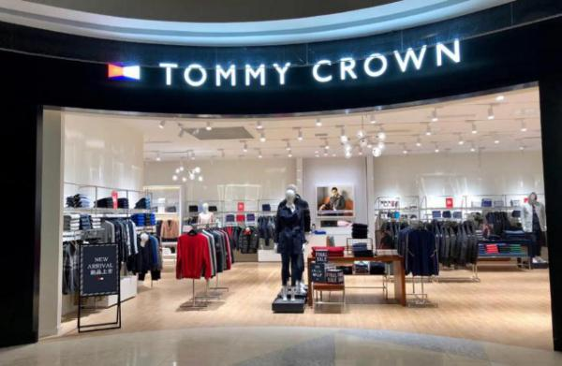
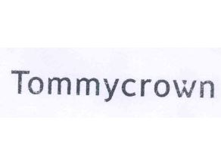



IP Enforcement

Slide 13



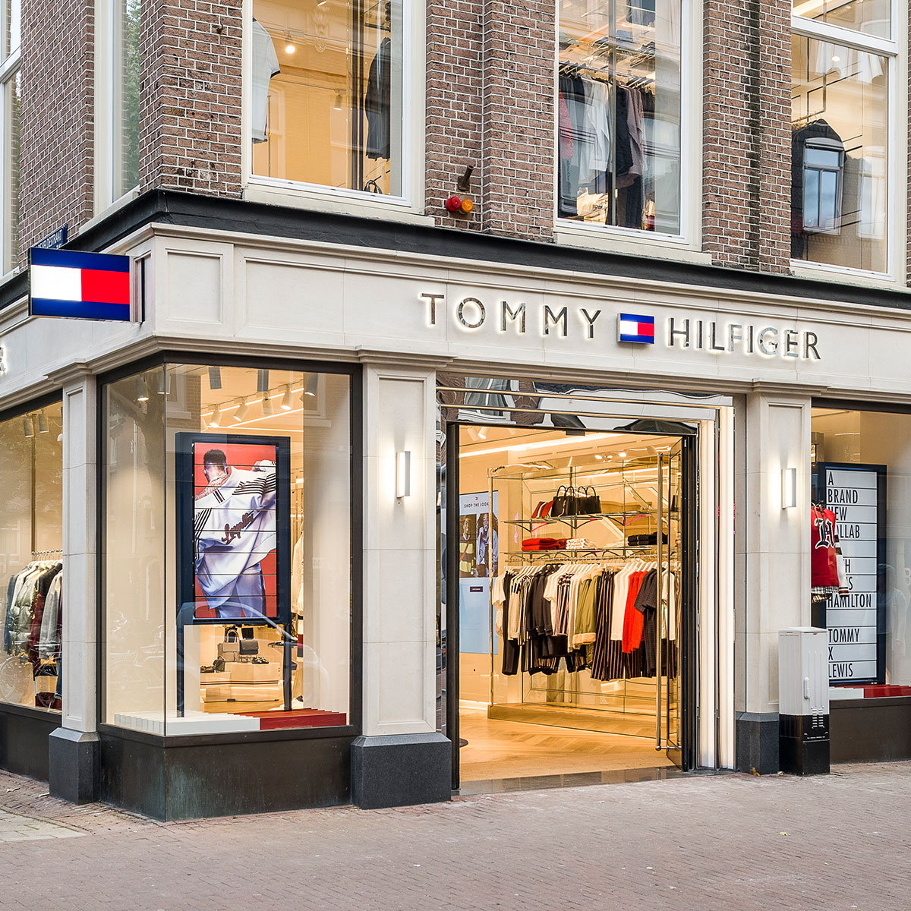

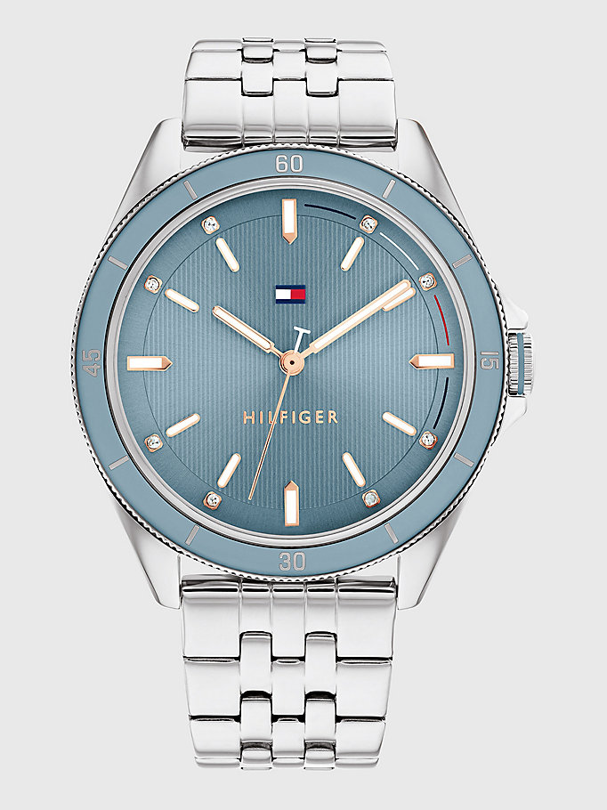



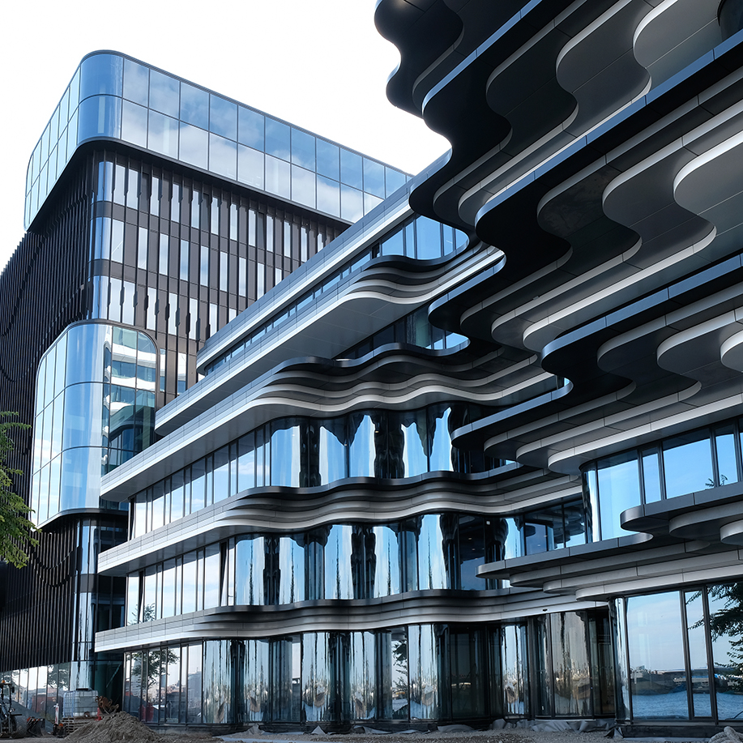

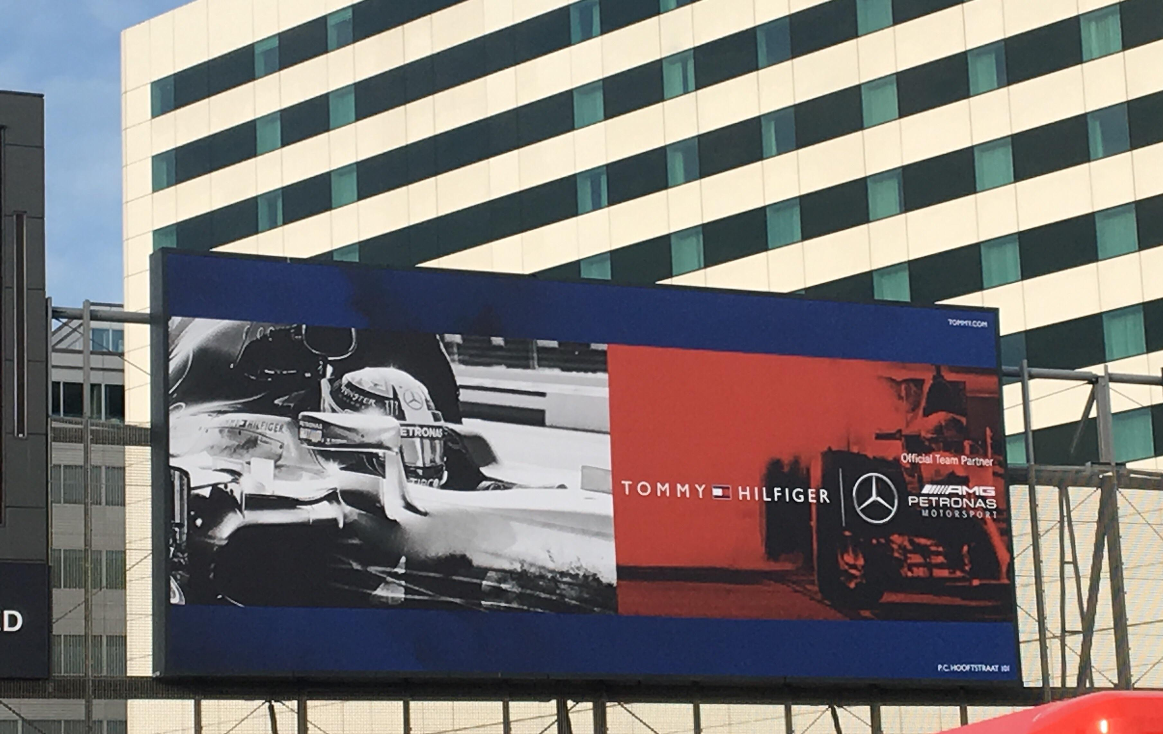
IP Commercialisation (Licensing)

Slide 14
Who We Are
Professional membership organisation which represents the interests of the trade mark and design profession
1600+ members
  Chartered Trade Mark Attorneys
  Trainee Trade Mark Attorneys
  Administrators / Paralegals
  Barristers and Solicitors with a trade mark / design interest
Seeks to influence authorities (UK and overseas) to ensure that trade mark and design protection systems work for the benefit of owners and users of the system
Maintains relationships with UK government and other international organisations (e.g. EUIPO, WIPO etc.)
Promotes importance of intellectual property to the wellbeing of businesses
Provides educational and networking opportunities

Slide 15
Strategic Objectives
Our Vision is to be recognised as one of the world’s leading organisations in the development, promotion and protection of the trade mark legal profession;
We aim to be valued by our members and seen as an important source of professional knowledge in the field of intellectual property law, with a focus on trade marks and designs.
Our three strategic objectives:
Passionately represent and promote the interests of the membership and the wider profession.
Equip, support and develop our membership to be competitive and successful both nationally and internationally.
Encourage and facilitate engagement in our work to enhance the profession and the organisation, inspiring a positive, healthy and inclusive culture.

Slide 16
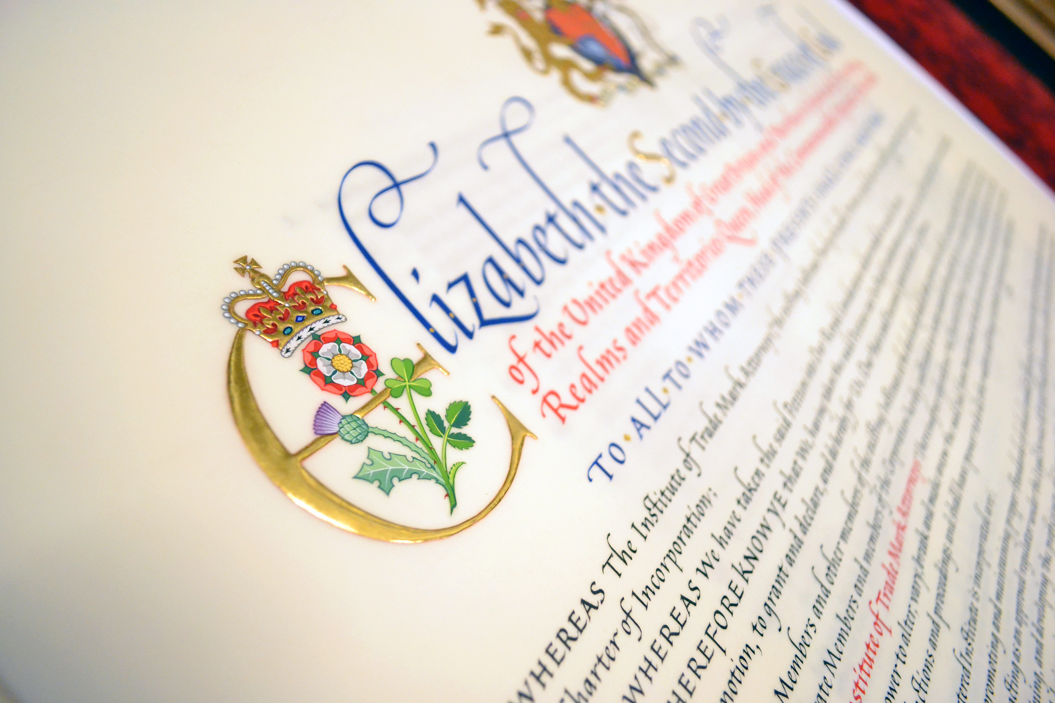
Royal Charter
It was at Windsor Castle, at a meeting of the Privy Council that the Institute was granted the Royal Charter on 12th April 2016. This culminated in the Great Seal of the Realm being applied by HM Crown Office in November 2016 and the Royal Charter legally coming into effect.
A landmark achievement for the Institute, the Royal Charter recognises its members’ distinctive and pre-eminent position as legal experts in the trade mark and design community.

Slide 17

Regulation and IPReg
CITMA is the Approved Regulator named in the Legal Services Act 2007 and is responsible for the regulation of the trade mark attorney profession.
This function is required to be separate from the representative operations of CITMA and therefore regulation has been delegated to a separate regulatory arm, which operates at arms length under the Intellectual Property Regulation Board (more commonly referred to as IPReg).
IPReg is responsible for:
Setting the education and training requirements for qualification as a trade mark attorney
Setting the requirements for continuous professional development in order that the trade mark attorneys knowledge, skills and expertise are maintained at a high level
Setting and maintaining a code of conduct for the professions
Handling complaints of professional misconduct against trade mark attorneys and where appropriate taking disciplinary or other action.

Slide 18
Further Information
CITMA
https://www.citma.org.uk/careers/becoming_a_chartered_trade_mark_attorney
IPReg
https://ipreg.org.uk/pro/getting-qualified/
Careers in Ideas
http://careersinideas.org.uk/
IP Careers
http://ipcareers.co.uk/

Slide 19
QUESTIONS?

