Slide 1


Welcome to our Webinar
Your speaker is
Ann Charlton
Sponsored by
www.citma.org.uk

Slide 2

Why mental health matters

Slide 3

What is mental health?
WHO defines mental health as:
‘a state of wellbeing in which every individual realises his or her own potential, can cope with the normal stresses of life, can work productively and fruitfully and can make a contribution to his or her community’

Slide 4
What is mental health?
  “A person’s condition with regard to their psychological and emotional wellbeing”
Everybody has mental health
Stigma
Just like physical health, we can learn techniques to help ourselves cope with and, recover from times when our mental health is below par.

Slide 5
What is wellbeing?
It’s about how we feel
How we think
Our relationships
How we find meaning & purpose in our lives…

Slide 6
Why does wellbeing matter?
Greater self-esteem
Optimism
Resilience
Vitality
Self-determination
Better physical & mental health etc etc

Slide 7
Why workplace mental health ?
Looking after people’s mental health is worthwhile for individuals and the firm
On the agenda for the World Economic Forum and governments
Time to be proactive, not reactive

Slide 8

Why does this matter in the legal workplace?
Individual
Employer
Wider legal community
General public

Slide 9
Individual
Competent –clarity of mind
Be at your best
Productive, creative, better communicator
Resilient
Work smarter
High ethical standards -integrity and honesty

Slide 10
Employer
Recruitment and retention
Happy people are productive people
Leadership – get the best out of people
Reputation
Risk management
SRA requirements

Slide 11

Wider community
Rule of law and administration of justice
Public trust and confidence
Sustainability

Slide 12
The facts
Law is third most stressful job in UK according to H&SE
82% of junior lawyers stressed
US study: 28% lawyers depressed, 19% anxious, 23% stressed, 21 per cent screened positive for hazardous, harmful and potentially alcohol-dependent drinking.

Slide 13
MIND survey September 2018
Survey of 44,000 revealed poor mental health affects half of all employees
Main reasons cited for concealment include fear, shame and job insecurity
Poll by Institute of Directors revealed poor relationships with line managers and workload biggest impact followed by relationships with colleagues

Slide 14
HSE Statistics November 2017
Work-related stress accounts for 40% of all work-related ill health cases in Great Britain
49% of all working days lost due to ill health
Over 12.5 million days lost due to work-related stress, depression or anxiety
Estimated economic cost over £5billion
Main factors cited were workload pressures, tight deadlines, too much responsibility and lack of managerial support

Slide 15
Admission or Denial?
“As lawyers we identify ourselves as problem solvers. But we also live lives dominated by high expectations and multiple demands”.
“We are often convinced that any admission of the stress our lives generate is a sign of weakness that will undermine everything we strive to be”.
“No one is immune and most of us cannot cope alone.”
Chief Justice Christine Durham, Utah State Bench

Slide 16
The facts
US ABA 2016 study: 28% lawyers depressed, 19% anxious, 23% stressed
Law Society’s JLD survey 2019 – 1800 respondents, 48% had experienced mental ill health in the previous month
Mental health problems at work cost the UK economy nearly £35bn last year

Slide 17

The legal workplace
Competitive
Pressured
Long hours culture
Managing expectations
Hierarchical
Negative emotion

Slide 18
Stress Demands
Stress is a balancing act between the demands or pressures that we experience and our resources and abilities to cope
Demands – external events, internal thoughts, physical problems and relationships
Resources – internal – the way we see life, our perceptions, the skills we have and the support we get from work and home

Slide 19
Stress v. Pressure
A bit of pressure is good for us
No pressure = no motivation = no action= no reward
Peak performance is achieved when optimum level of pressure enables us to work at our best - different for everyone

Slide 20

What organisations can do
Wellbeing is a leadership duty
Create an environment where people can perform at their best
Embed positive approaches
Build wellbeing into strategy
Promote culture of acceptance

Slide 21

Practical steps
Raise awareness – World Mental Health Day Oct 10, Mental Health Awareness Week May
Encourage a better work life balance
Provide learning and development
Supervision
Sharing lived experiences
Signpost to support – EAP, LawCare
Try putting up posters

Slide 22
Self-Care Alarm Bells
Inability to switch off
Feeling completely overwhelmed
Being prickly (more than usual)
Aches, pains, bumps & lumps
Cancelling Plans
Loneliness
Irrational behaviour

Slide 23
Stress Indicators
Emotional
Wanting to cry/Feeling Frozen
Feeling can’t cope
Irritability
Loss of motivation
Low self-esteem

Slide 24
Stress Indicators
Mental
Muddled thinking
Mind racing or going blank
Poor memory
Confusion
Inability to plan, concentrate, control

Slide 25
Stress Indicators
Physical
Increase in aches and pains
HBP/Breathlessness
Loss/Gain weight – Digestive Problems
Frequent headache
Fatigue

Slide 26
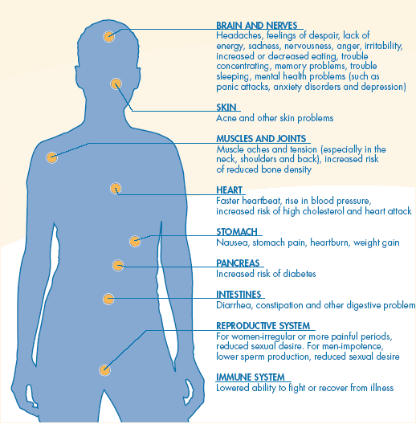
The Effects of Stress

Slide 27
Classic Stress Symptoms
Changes in behaviour
Getting less work done
Deterioration in relationships
Accident prone
Change in sleep patterns
Increase in smoking, drinking, eating etc.

Slide 28
Self-Care
Caring for myself is NOT self-indulgence, it is self-preservation.
To love oneself is the beginning of a lifelong romance. Oscar Wilde

Slide 29
Mitigating Stress
Recognise when you are stressed
Take personal responsibility
Change what you can
Or – adopt acceptance
Don’t waste time and energy on things you cannot change

Slide 30
Spot the warning signs
Remember the signs
Get outside help – see your GP, tutor, student counsellor, team leader, manager, HR, Departmental Head, Head of Chambers
Talk to someone you trust
Prevention is better than cure
Ring LawCare or another helpline – it really is good to talk /family/Samaritans etc

Slide 31
Stress can be managed
Work out a quick break /fire break that works for you to relieve immediate pressure
Take a minute of “me time” if you are feeling under pressure
Take a break – mid morning, lunch and mid afternoon on as many days as possible
Take back control

Slide 32
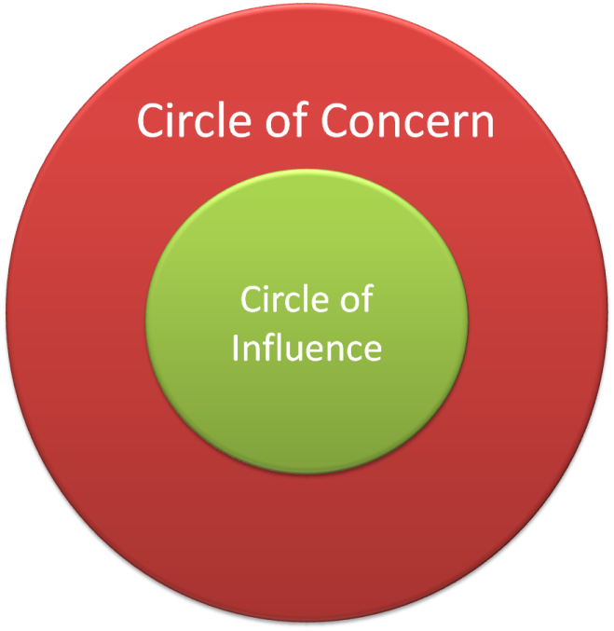
Working smarter not harder
Ask yourself
What can I be doing rather than
What can I be worrying about?

Slide 33

Strategies to Manage Stress
Time Management
Recognise your “prime time” – when are you at your best?
High/low value tasks
Manage your day actively – don’t just let it happen
Do not procrastinate
Recognise time wasters
Set realistic deadlines

Slide 34
Strategies to Manage Stress
Mental Attitude
Keep things in perspective
Think positive – challenge negative thoughts
`The pessimist sees the difficulty in every opportunity, the optimist sees the opportunity in every difficulty` - Churchill
Live in the now – learn from mistakes but don’t dwell on them
Be kind to yourself and reward yourself when you do well

Slide 35
Strategies for Success
Supporting Yourself
  Stress proof yourself so less physically receptive to stressors when they occur – be prepared
  Get a good night’s sleep
  Maintain fitness
  Eat healthily
  Drink in moderation

Slide 36

Taking Care of Yourself
YES, YOU!

Slide 37
Preventing Stress – a guide to having a good year
R
The 6 Rs of Stress Prevention
  Responsibility
  Reflection
  Relaxation
  Relationships
  Refuelling
  Recreation:

Slide 38
What can firms/organisations do?
Create a culture of acceptance
Raise awareness
Training and development
Signpost to support

Slide 39
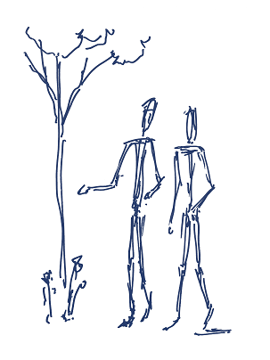
A culture of acceptance
It starts from the top
Challenge stigma
Treat each other with respect
Create an environment where
people can be at their best

Slide 40
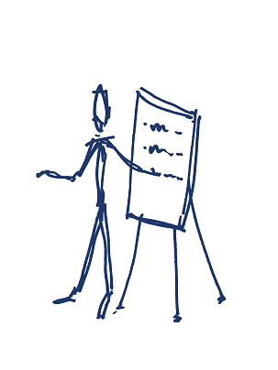
Training and development
Managers – supervision
Mental Health First Aid
Mind wellbeing index
Mindful business charter

Slide 41


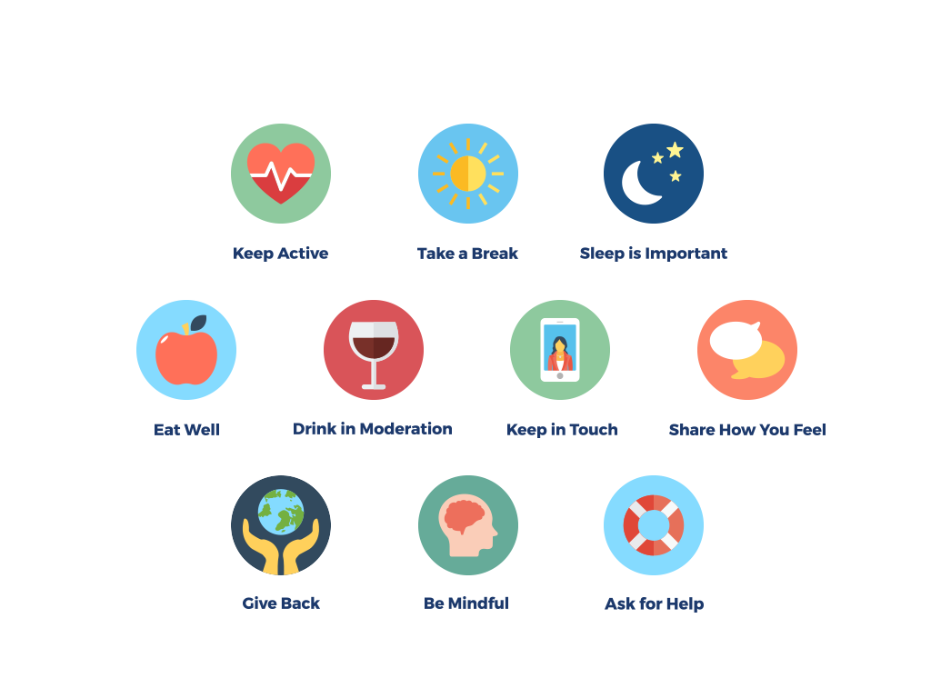
Notes:
There are 5 simple steps we can all take to improve our wellbeing
Connect – connect with the people around you, your family, friends, colleagues and neighbours, its important to spend time developing these relationships
Be active- this doesn’t mean going to the gym – go for walk, cycle, play football, find an activity that you enjoy and make it part of your life
Keep learning – learning new skills can boost confidence
Give to others – even small acts such as a kind word or a thank you count, larger acts such as volunteering can improve your wellbeing
Be mindful – be more aware of the present moment, including your feelings and thoughts, your body and the world around you, ‘mindfulness’ can positively change the way you feel about life and how you approach challenges.
But why does wellbeing matter in a professional context? There are many benefits – greater self esteem, optimism, resilience, vitality, self determination, positive relationships with colleagues, better physical and mental health, greater motivation, creativity and more productive work.
From an employer’s perspective actively improving wellbeing, may help to attract a talented and diverse range of students to enter the legal profession, help with staff retention, reduce sick days, increase productivity and give an edge over competitors. For the wider legal community improving wellbeing will help maintain the professional reputation of lawyers and advance the administration of justice.

Slide 42
And another thing…
“They always say time changes things but you have to change them for yourself.”
Andy Warhol

Slide 43
What is LawCare?
The charity that promotes and supports good mental health and wellbeing in the legal profession
Established in 1997
Funded by, but independent of, professional bodies
Covers the UK and Ireland
All branches of the legal profession

Slide 44
Support
Our support spans the whole of legal life, from student to training through to practice and retirement , which includes all staff
We can help those concerned about themselves, a colleague, friend, or family member
We understand life in the law

Slide 45
About LawCare www.lawcare.org.uk
Support – helpline, peer support, webchat
Education and prevention – raise awareness, tackle stigma, information, training
Research – understand the impact the culture and practice of law has on wellbeing
Create change – drive positive change in education, training and practice

Slide 46

Support – Helpline, email, webchat
Free, independent, confidential
Discuss concerns
Listen without judgment, with empathy
Trained staff / volunteers have worked in the law
Signposting
Best practice standard

Slide 47

Support – Peer Support
Network of peer supporters
One to one support
Reassurance

Slide 48
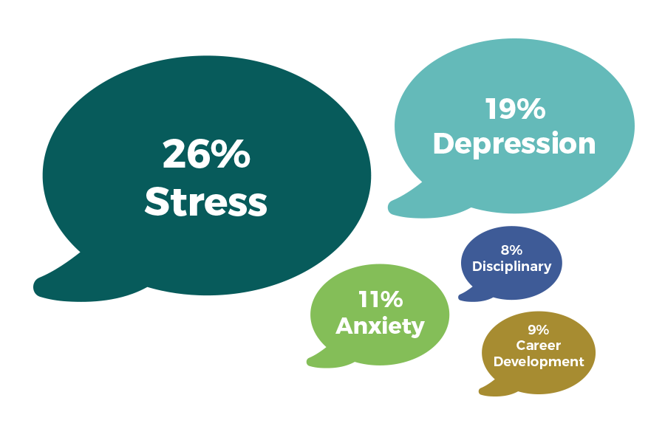
Why people contact us

Slide 49
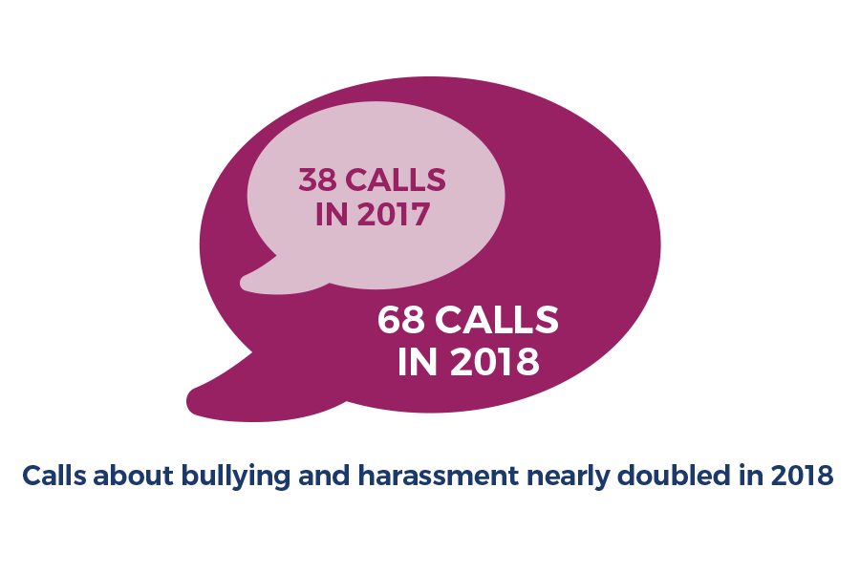
Why people contact us

Slide 50
Information
Website www.lawcare.org.uk
Factsheets
Wellbeing tips
Tips for healthy workplaces
LawCare News
Case studies / blogs

Slide 51


LawCare
Helpline: 0800 279 6888
Free and confidential weekdays 9-5.30
Website: www.lawcare.org.uk
Factsheets and information
Registered charity

Slide 52
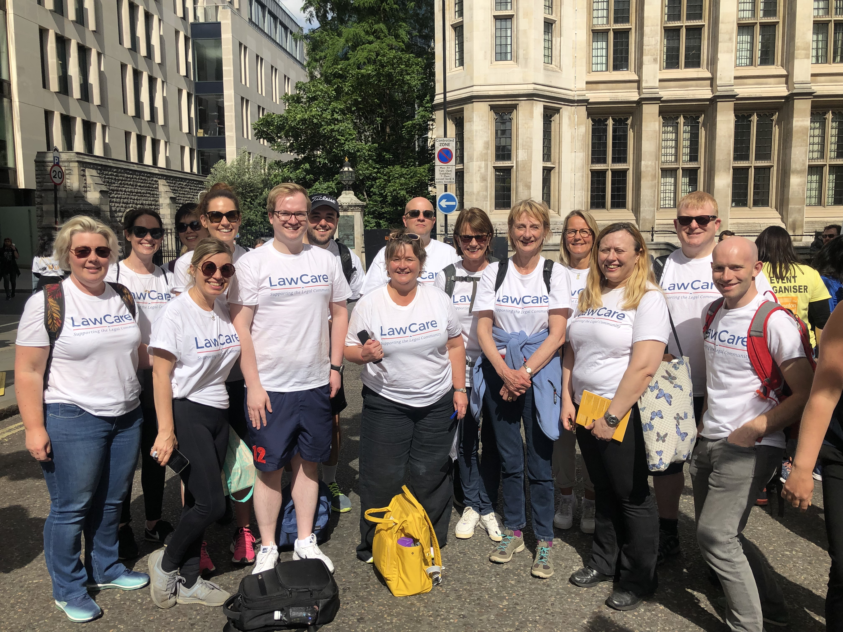



Support the movement
Sign up to our newsletter
Follow us
Fundraise /Donate
Be a champion
www.lawcare.org.uk

