Slide 1
Brexit & IP
Tania Clark, CITMA President
Kate O’Rourke, CITMA Immediate Past-President
Julia Florence, CIPA President
Stephen Jones, CIPA Immediate Past-President
25th February 2019

Slide 2
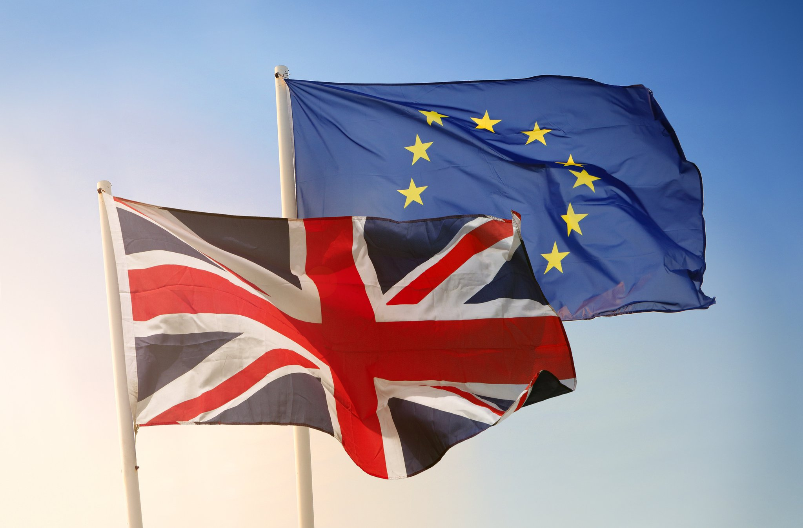
25th February 2019

Slide 3
Brexit
The background and the international context
The impact on intellectual property rights
The terms of the draft Withdrawal Agreement and the no deal plans
Key action points
25th February 2019

Slide 4
Timeline
23rd June 2016 | Referendum on Brexit
29th March 2017 | Article 50 triggered
13th July 2017 | European Union (withdrawal) Bill published
18th January 2018 | Q&A published by EUIPO
8th February 2018 | Technical note published by UK Government
28th February 2018 | European Commission publishes draft Withdrawal Agreement
19th March 2018 | UK Government publishes draft Withdrawal Agreement highlighting agreed elements
25th February 2019

Slide 5
Timeline (2)
26th June 2018 | UK Parliament passes the EU (Withdrawal) Act
14th November 2018 | Draft Withdrawal Agreement as agreed between the EU and the UK published
15th January 2019 | UK Parliament rejects the EU (Withdrawal) Act
29th March 2019 | UK leaves the EU if there is no deal
31st December 2020 (or later) | Transition period ends if there is a deal
25th February 2019

Slide 6
The international context
IP is underpinned by many long-standing international IP agreements, with the same or very similar rights in many territories
These include:
Agreement on Trade-Related Aspects of Intellectual Property Rights (TRIPS) administered by the World Trade Organisation for all forms of IP
The Paris Convention for the Protection of Industrial Property
The Madrid Agreement and Protocol for trade marks
The Berne Convention for copyright
The European Patent Convention
The Hague Agreement for the International Registration of Industrial Designs
So the underlying fundamental principles will not change
25th February 2019

Slide 7
The effect of Brexit on IP
The UK remains a Member State of the EU until formal withdrawal
EU law will continue to have effect in the UK until the UK actually leaves the EU (or until the end of the transition period)
National IP rights are unlikely to be affected post-Brexit
Pan-European IP rights will be affected, particularly trade marks, designs, geographical indications of origin and plant variety rights
25th February 2019

Slide 8
Trade marks and designs– significant impact
New EU trade mark and designs filings post-Brexit will not extend to the UK (they will be limited to the remaining 27 EU countries)
Trade mark and design owners will need to seek national protection in the UK for their trade marks and designs post-Brexit
Application through the Madrid Protocol still available for International trade mark Registrations designating the UK
Application under the Hague Agreement available to file designs in the UK (since 18th June 2018)
25th February 2019

Slide 9
Unregistered designs – significant impact
The benefit of the EU wide unregistered community design right (UCDR) will be lost in the UK
UCDR is significant for short life designs, e.g. fashion
The benefit of UCDR will remain available to UK and other non-EU residents and corporations
But – subject to designs being first made available in the EU
UK unregistered design right does not provide the same protection as UCDR
Protects 3D designs, but not 2D elements of designs
UK Government has prepared draft legislation to introduce a “supplementary unregistered design right” to mirror the protection of UCDR
25th February 2019

Slide 10
Brexit – agreed terms of departure
EU trade marks | Withdrawal Agreement | No deal
Registrations | New UK rights are created automatically at the end of the transition period (31 December 2020 or an agreed later date) | Comparable UK marks (EU) are created automatically at exit day (29 March 2019)
 | No fees | No fees
 | Unclear whether proprietors will be notified of new rights being granted | A notification will be made and guidance given on the UKIPO website that a comparable mark (EU) has been created. The proprietor can opt out of ownership, if the mark has not been used or made subject of a transaction or proceedings
 | Filing, priority, seniority and renewal dates the same as for corresponding EUTM | Filing, priority, seniority and renewal dates the same as for corresponding EUTM
25th February 2019

Slide 11
Brexit – agreed terms of departure (2)
EU trade marks | Withdrawal Agreement | No Deal
Registrations | Recognition of genuine use in EU27 countries before end of transition period will support validity of comparable UK right | Confirmation that genuine use in EU27 countries before exit day will support validity of comparable mark (EU)
 | Cancellation of corresponding EUTM (in proceedings started before end of transition period) means cancellation of comparable right as of same date unless grounds do not apply in UK | UK court may cancel comparable mark (EU) if corresponding EUTM is cancelled in pending UK proceedings
 | Comparable right continues to benefit in the UK from reputation acquired in the EU by end of transition period | Reputation of comparable mark (EU) to be treated as encompassing use made in EU27 countries before exit day
25th February 2019

Slide 12
Brexit – agreed terms of departure (3)
EU trade marks | Withdrawal Agreement | No deal
Applications | Nine months from end of transition period (until end of September 2021) to file corresponding UK application with same filing, priority and seniority dates as corresponding EUTM. No indication that application will be notified of the need to re-file. The usual fees will be payable. | Nine months from exit day (until end of December 2019) to file corresponding UK application with same priority, seniority, renewal and filing dates as corresponding EUTM. Applicants will not be notified of need to refile and the usual fees will be payable.
25th February 2019

Slide 13
Brexit – agreed terms of departure (4)
EU designs | Withdrawal Agreement | No deal
Registrations | Equivalent UK rights will arise automatically from RCDs registered by end of transition period | Comparable UK rights will arise from RCDs registered by exit day
 | No fees | No fees
 | Unclear whether proprietors will be notified of equivalent rights | Proprietors to be notified of creation of comparable rights and can opt out of ownership
 | Filing, priority and renewal dates as for corresponding RCD | Filing, priority and renewal dates as for corresponding RCD
 | Cancellation of corresponding RCD (in proceedings started before end of transition period) means cancellation of equivalent right as of same date unless grounds do not apply in UK | Position not yet confirmed but likely to be the same as under the Withdrawal Agreement
 | Duration of equivalent right at least as long as duration of corresponding RCD | Duration of comparable right at least as long as duration of corresponding RCD
25th February 2019

Slide 14
Brexit – agreed terms of departure (5)
EU designs | Withdrawal Agreement | No deal
Applications | Nine months from end of transition period (until end of September 2021) to file corresponding UK application with same filing, priority and seniority dates as corresponding RCD application. No indication that applicant will be notified of the need to re-file. The usual fees will be payable. | Nine months from exit day (until end of December 2019) to file corresponding UK application with same priority, seniority, renewal and filing dates as corresponding RCD application. Applicants will not be notified of need to refile and the usual fees will be payable.
Unregistered Community Design Rights
 | Equivalent UK rights mirroring UCD right arise automatically from UCD rights subsisting at the end of transition period, and have term at least as long as that of corresponding EU right | Equivalent UK rights arise automatically from UCD rights subsisting on exit day, and have term at least as long as that of corresponding EU right.
 |  | UK to create new supplementary unregistered design right offering same terms of protection as UCD right, for designs first disclosed in UK after exit
25th February 2019

Slide 15
Brexit – agreed terms of departure (6)
International trade marks and designs | Withdrawal Agreement | No deal
 | UK to take measures to ensure continued protection in the UK of international trade mark and design registrations designating the EU | UK government has confirmed continued protection in the UK of international trade mark and design registrations designating the EU as new UK registrations, not UK designations
Exhaustion of rights | Withdrawal Agreement | No deal
 | Rights exhausted in the UK and EU before the end of the transition period will remain exhausted in both territories | Rights exhausted in the UK and EU before the end of the transition period will remain exhausted in both territories Post Brexit, UK will recognise exhaustion of rights in goods marketed in EEA but EU has not yet agreed to recognise exhaustion of rights in goods marketed in UK.
25th February 2019

Slide 16
Rights of representation
 | Withdrawal Agreement | No deal
EU trade marks and designs | During the transition period (until 31st December 2020 or longer) those people who presently have the right to represent clients before the EUIPO will maintain their rights and will be entitled to continue to act on pending matters after the transition period. | It is likely that UK representatives will formally lose their rights of representation on 29th March 2019. There should be a minimum of 2 months for rights holders to change their representative to one based in the EEA.
UK trade marks and designs | The draft Agreement states that rights holders shall not be required to have a correspondence address in the UK in the 3 years following the end of the transition period. | It is not intended to change the current arrangement where a rights holder can use an address for service in the EEA.
25th February 2019

Slide 17
Action points
Double filing
Consider double filing national applications in the UK and in the EU if registration of the trade mark or design will not be completed by 29th March 2019 or 31st December 2020 (if there is a transition period). EU designs are registered within 24 hours. If you are filing International Registrations designating the EU, we recommend also adding a UK designation. Double filing will also be required to ensure that you have rights in the EU as well as in the UK since after exit a UK right will no longer be relevant to an EUTM application.
Use
If use is only in the EU27 and not in the UK, consider expanding use in the future since the UK cloned registration will become vulnerable to cancellation for non-use.
Licences / security interests
Check whether any licences or security interests have been recorded against the EUTM and should be recorded against the cloned UKTM?
25th February 2019

Slide 18
Action points (2)
Ongoing EU opposition and invalidation proceedings
If they are based solely on the UK right, that right probably will not be a valid right after exit. The draft Withdrawal Agreement is silent on this point but the EUIPO's earlier Q&As published on 20th July 2018 on a no-deal Brexit indicated that proceedings based on UK rights would fall away as groundless on exit day.
Pending EUTM / RCD
Diarise 9 months from exit day to ensure all UK national applications have been filed for trade marks and designs.
Cloned UKTM
Consider whether these should be surrendered after exit because existence of the registration could contravene earlier agreement.
25th February 2019

Slide 19
More action points (3)
Pending proceedings
Trigger the ending of cooling off periods in pending oppositions or expedite ongoing proceedings to ensure completion before exit date.
Renewals
Renewing the earlier EUTM which is due for renewal post exit will not result in avoiding the renewal fee for the UK cloned registration. This right is only being granted as of the date of exit and will require separate renewal but the UKIPO will waive any late fees for the first 6 months.
Seniority
Seniority claims made in the EU registration will be respected in the cloned UK registration and the cloned UK registration will be deemed to have the same rights as if the senior mark had continued to be registered in respect of all the goods/services for which it was registered prior to the surrender or lapse. Consider renewing UK registrations rather than claim seniority
25th February 2019

Slide 20
More action points (4)
Contracts
Review existing contracts and amend clauses relating to jurisdiction, governing law and territory to include the UK as well as the EU. Review distribution agreements in anticipation of changes to the exhaustion regime.
.eu domain names
Can only be held in the name of an EU based company and therefore ownership will need to be transferred.
25th February 2019

Slide 21
More action points (5)
Rights of representation
The EUIPO should notify rights holders who continue to have a UK representative asking them to change but this has not yet been confirmed.
To maintain your EUIPO rights of representation you need to be the following:
1. Legal practitioner qualified in the EEA and place of business in the EEA but does not need to be the same EEA member state.
2. Professional representative who is a national of an EEA member state and entitled to act before the Trade Mark Office of the EEA and has a place of business or employment in an EEA member state. Again the individual does not need to be qualified and have place of business in the same EEA member state.
3. Employee representative: an individual employed by a company or individual which has in the EEA either a domicile, principal place of business or real and effective industrial or commercial establishment and is acting for their employer. Therefore, a UK based in-house practitioner can act before the EUIPO for all companies within the group provided that their employer has domicile or relevant activity within the EEA.
25th February 2019

Slide 22
More action points (6)
Exemptions
It is possible to apply to the EUIPO for an exemption to the nationality requirement. This decision is at their discretion but it might be worth applying on an individual basis.
Privilege for non-UK trade mark attorneys in English court proceedings
Only a UK qualified trade mark attorney will be able to benefit from claiming privilege in documents which can then be withheld from disclosure during the disclosure process in English court proceedings. Therefore, only UK barristers, solicitors and attorneys will be covered by legal privilege and not EEA/non-UK attorneys/lawyers.
25th February 2019

Slide 23
Patents (and SPCs) after Brexit

Slide 24
What determines the status of IP in the UK after Brexit?
European Union (Withdrawal) Act 2018
Withdrawal Agreement – Nov 2018
Technical Notices from EU and UK
Future relationship with EU
Summarised in UK Govt guidance at:
https://www.gov.uk/guidance/intellectual-property-after-brexit

Slide 25
European (EPC) Patents
NO CHANGE – Business as usual
EPO is not an EU institution
EPC is not EU law
UK EP Attorneys can continue to act before the EPO
UK can still be designated in an EPC patent filing
We need to keep repeating this message to our overseas associates
Still much confusion

Slide 26
Draft SI relating to patents The Patents (Amendment ) (EU Exit) Regulations 2018
Purpose - to fix what would break and to do so in a way that preserves the current operation of the law
Replacing references to EU bodies or laws with UK equivalents in the following:
Patents Act 1977 – compulsory licences
CDPA 1988
Patents and Plant Variety Regulations 2002
Patent Rules 2007
SPCs for Plant Protection Products
Compulsory Licensing of Pharmaceutical Patents – Regulation EC 816/2006
SPCs for Medicinal Products

Slide 27
Supplementary Protection Certificates (SPCs)
Granted at EU exit – already a national right – no change
Pending at EU exit, or filed after EU exit:
No deal - dealt with under domestic UK law - EU regulation as amended by SI
Deal - current EU regulation will continue to apply during transition period (Art 56, Withdrawal Agmt)
After transition period – EU regulation as amended by SI? Depends on outcome of future relationship negotiations

Slide 28
Effect of SI relating to SPCs
Replaces references to EU legislation and legal bodies with UK equivalents, e.g.:
Current SPC Reg | Amendment per SI
EU paediatric regulation | UK Human medicines regs
EU medicines authorisation under Directive 2001/83/EC | UK authorisation – defined with ref to UK human and veterinary medicines regultations
IPO of member state | Comptroller
Body responsible under national law for revocation of patent | Comptroller or court

Slide 29
Current SI relating to SPCs
But some references to EEA remain!
Art 8 – Content of Application for a certificate Art 9 – Lodging of Application for a certificate Art 11 - Publication
First authorisation to place product on market, plus First authorisation in EEA | UK authorisation, plus Earliest EEA authorisation which predates UK authorisation
Article 13 – Duration of certificate
Based on first authorisation in the Community | Based on first authorisation in the area comprising EEA and UK

Slide 30
UPC/Unitary Patent/Unitary SPCs
UPC – still awaiting outcome of German Constitutional Challenge
Can the UK participate after Brexit?
Govt position:
The UK will explore options on IP, including participation in the Unified Patent Court and Unitary Patent system, and providing for more extensive cooperation on intellectual property than is offered under existing multilateral treaties.

Slide 31
Address for Service Privilege
No immediate change for address for service rules in UK – address in EEA still acceptable
Privilege for patent attorneys will remain unaffected - this is not determined by reference to EU membership.

Slide 32
Exhaustion of rights
UK will continue to recognise EEA regional exhaustion – at least in short/med term
Parallel import of goods from EEA can continue
But not reciprocal – at least in event of no-deal
i.e. goods placed on the market in UK not exhausted vis-à-vis EEA

Slide 33
Status of the UK’s membership of the EUIPO after Brexit

Slide 34
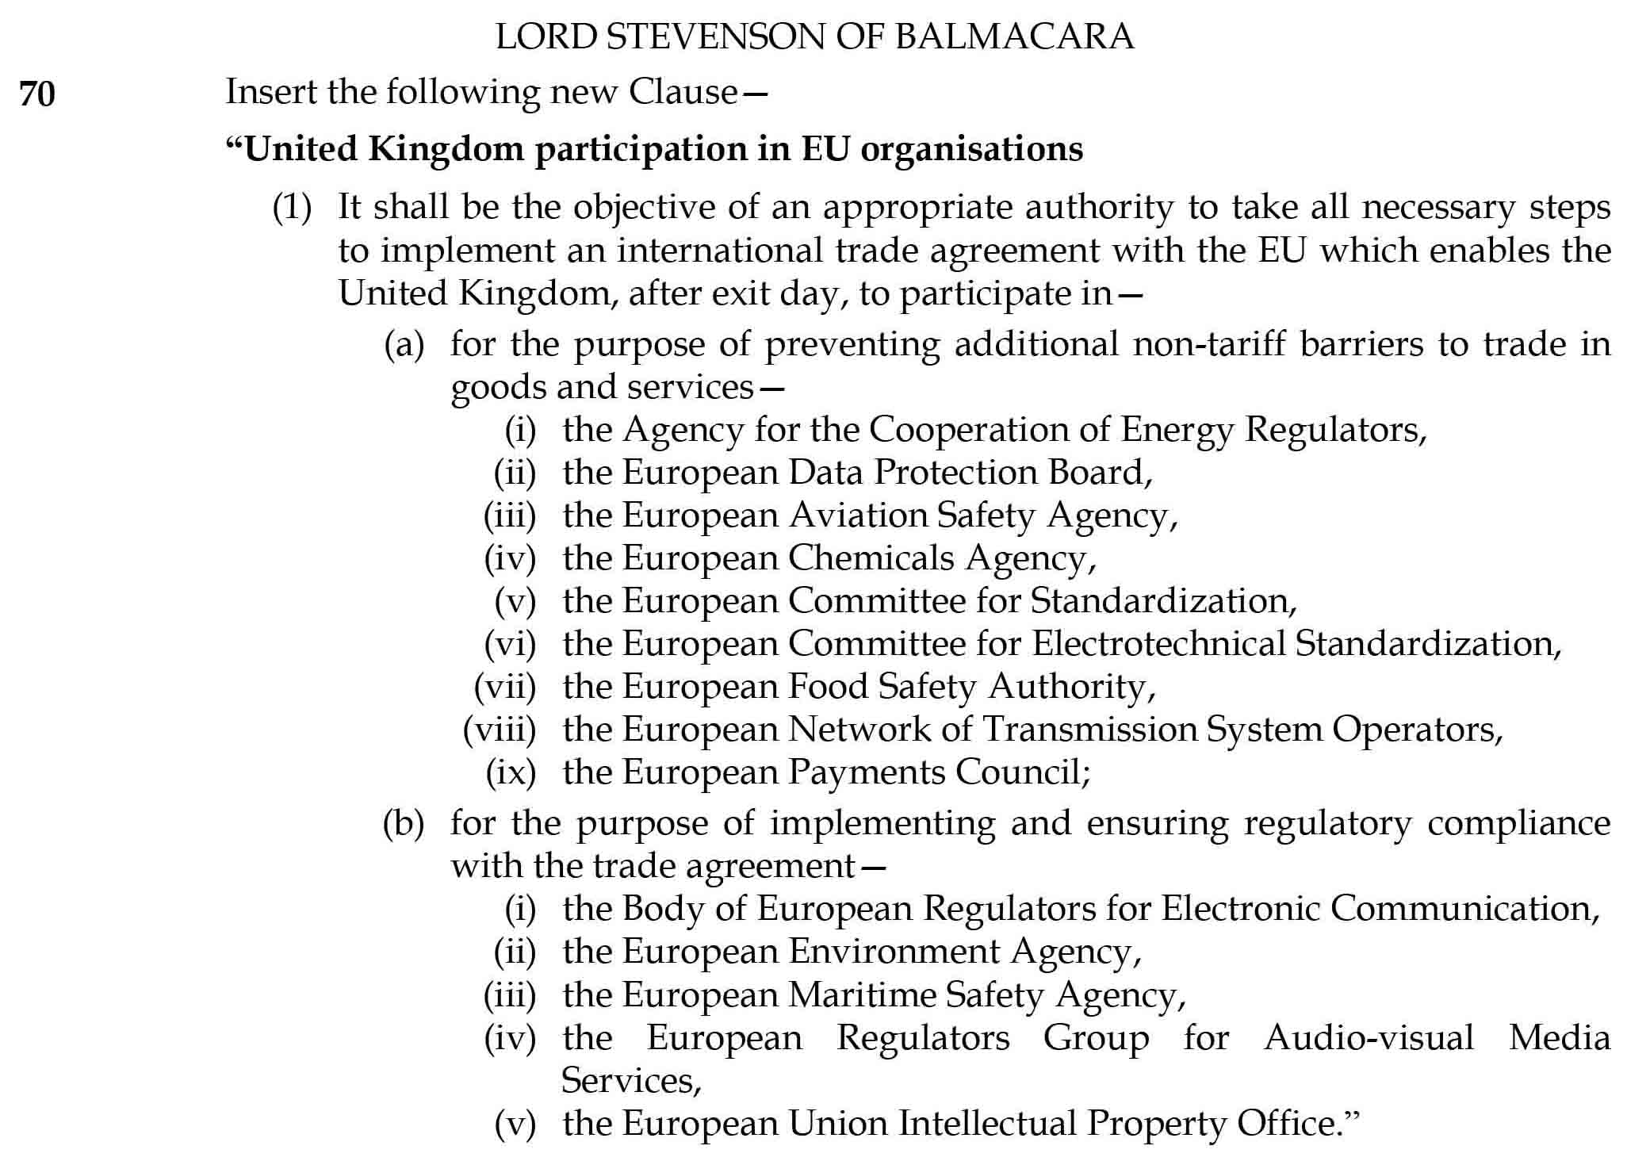

Slide 35
Thank you for listening

