Slide 1
CITMA Webinar - IPReg Education Review: Insights from the call for evidence and feedback
Katie Flett, IPReg
Sally Gosling, IPReg

Slide 2

Education Review Call
findings and next steps
Evidence from the 2026 Call for Evidence and Feedback
November 2026

Slide 3
AGENDA
Today’s session
01
Profile of Call responses
05
Widening entry to the professions
02
Key messages from responses
06
Trade mark attorney-specific findings
03
Changing practice needs
07
Next steps in the Review
04
Learning and development cultures and integration of experience, learning and assessment
08
Response to questions raised during the session

Slide 4
INTRODUCTION
About the Call
Four priority themes
February to April 2026
87 responses
Changing practice needs; learning and development cultures; integration of experience, learning and assessment; widening entry.
Sought evidence and feedback from across the professions, the wider IP sector, and from consumers.
Individuals and organisations responded through the online survey, email and direct engagement.
Additional approaches
Important caveat
Topic-based workshops and insight sessions to explore issues in more depth and address gaps in responses.
We’re using the Call findings inform the Review. They’re not conclusions or proposals, and no decisions have yet been made.

Slide 5
RESPONSE PROFILE
87 responses informed the analysis
Responses came from individuals, organisations and across the IP sector
53
34
48
individual responses
organisational responses
online survey responses
87
responses
38
1
2 professions
email submissions
verbal response
plus wider IP and consumer perspectives
Insight sessions strengthened input from trade mark and patent trainees, and secured input from medium-sized firms.

Slide 6
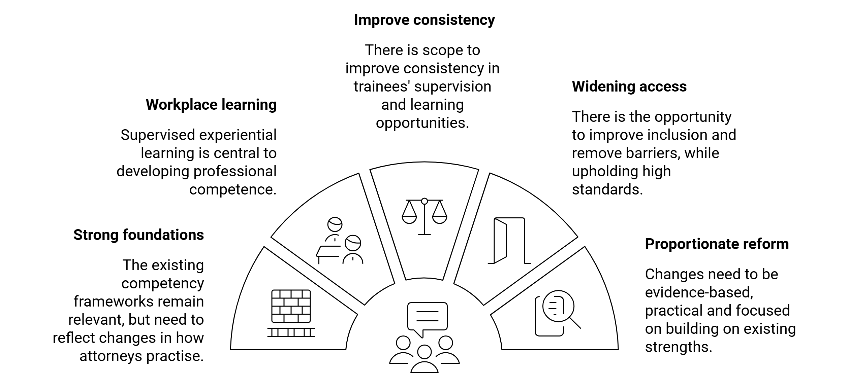
OVERALL MESSAGES
Key messages from Call responses

Slide 7
OVERALL MESSAGES
Strong foundations in a changing context
What remains strong
What’s changing
The core capabilities required to practise as an attorney remain largely unchanged.
Existing qualification routes provide strong foundations for each profession.
The focus of IPReg’s competence requirements remain fundamentally sound.
The contexts of practice, including
How AI is being used in service delivery.
More multi-disciplinary working.
Changing client needs and expectations.
More complex service delivery.
Increasing commercial pressures.
Increasing pace of change.
The prevailing sense was the need to respond to changing contexts, rather than wholesale change.

Slide 8
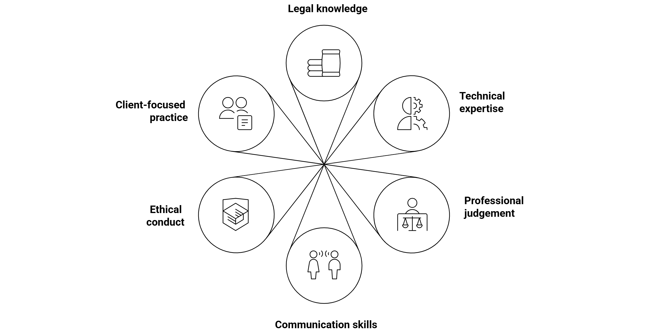
WHAT YOU TOLD US ABOUT CHANGING PRACTICE NEEDS
Core competence areas required for professional practice
Current competence requirements remain fundamentally sound,
but it’s increasingly important to be able to apply these in changing, more complex contexts.

Slide 9
WHAT YOU TOLD US ABOUT CHANGING PRACTICE NEEDS
The implications of AI for attorneys’ practice and trainees’ preparation for practice
Responsibility and accountability
Critical evaluation
Remains with the attorney, underpinned by adherence to safe, ethical practice.
Attorneys must be able to critique and verify AI-generated/-assisted outputs, underpinned by AI literacy.
AI changes the
context of practice
Technical learning
Key risks
Knowledge atrophy; fewer learning opportunities for trainees as service delivery models/workflows change.
Trainees still need to develop a deep understanding to underpin their activity.
AI was not generally seen as changing the capabilities required for safe and effective practice, but to be increasing the importance of some key capabilities.

Slide 10
WHAT YOU TOLD US ABOUT CHANGING PRACTICE NEEDS
What must newly-qualified attorneys be able to do on day one to practise safely and effectively? Different perspectives shared
Broad base of core requirements
Staged or setting-dependent development
An increasing breadth of knowledge, skills and behaviours are required for practice in the context of
Changing contexts and needs.
Mobility across sectors and settings.
Newly-qualified attorneys can practise independently or without access to supervision.
Some competences may safely be developed after registration through a staged approach to professional formation and in the context of
Early-career attorneys’ access to ongoing supervision and evolving scope of practice.
Attorneys’ engagement in career-long professional development.
Factors that relate to ‘day-one’ competence:
Demonstration of threshold competence
Awareness of personal scope of practice
Access to appropriate levels of supervision
Engagement in onward development
Ability to make independent decisions, with appropriate support

Slide 11
WHAT YOU TOLD US ABOUT CHANGING PRACTICE NEEDS
Competence update considerations
With a focus on being inclusive, flexible and non-prescriptive.
Professional ethics
Multi-disciplinary working
Critical evaluation of AI outputs/ethical use of AI
Commercial awareness
Consumer focus
Data protection and cyber-security
Sanctions
Anti-money laundering
All viewed as areas in which to strengthen core requirements to meet changing needs; not to replace existing competence requirements.

Slide 12
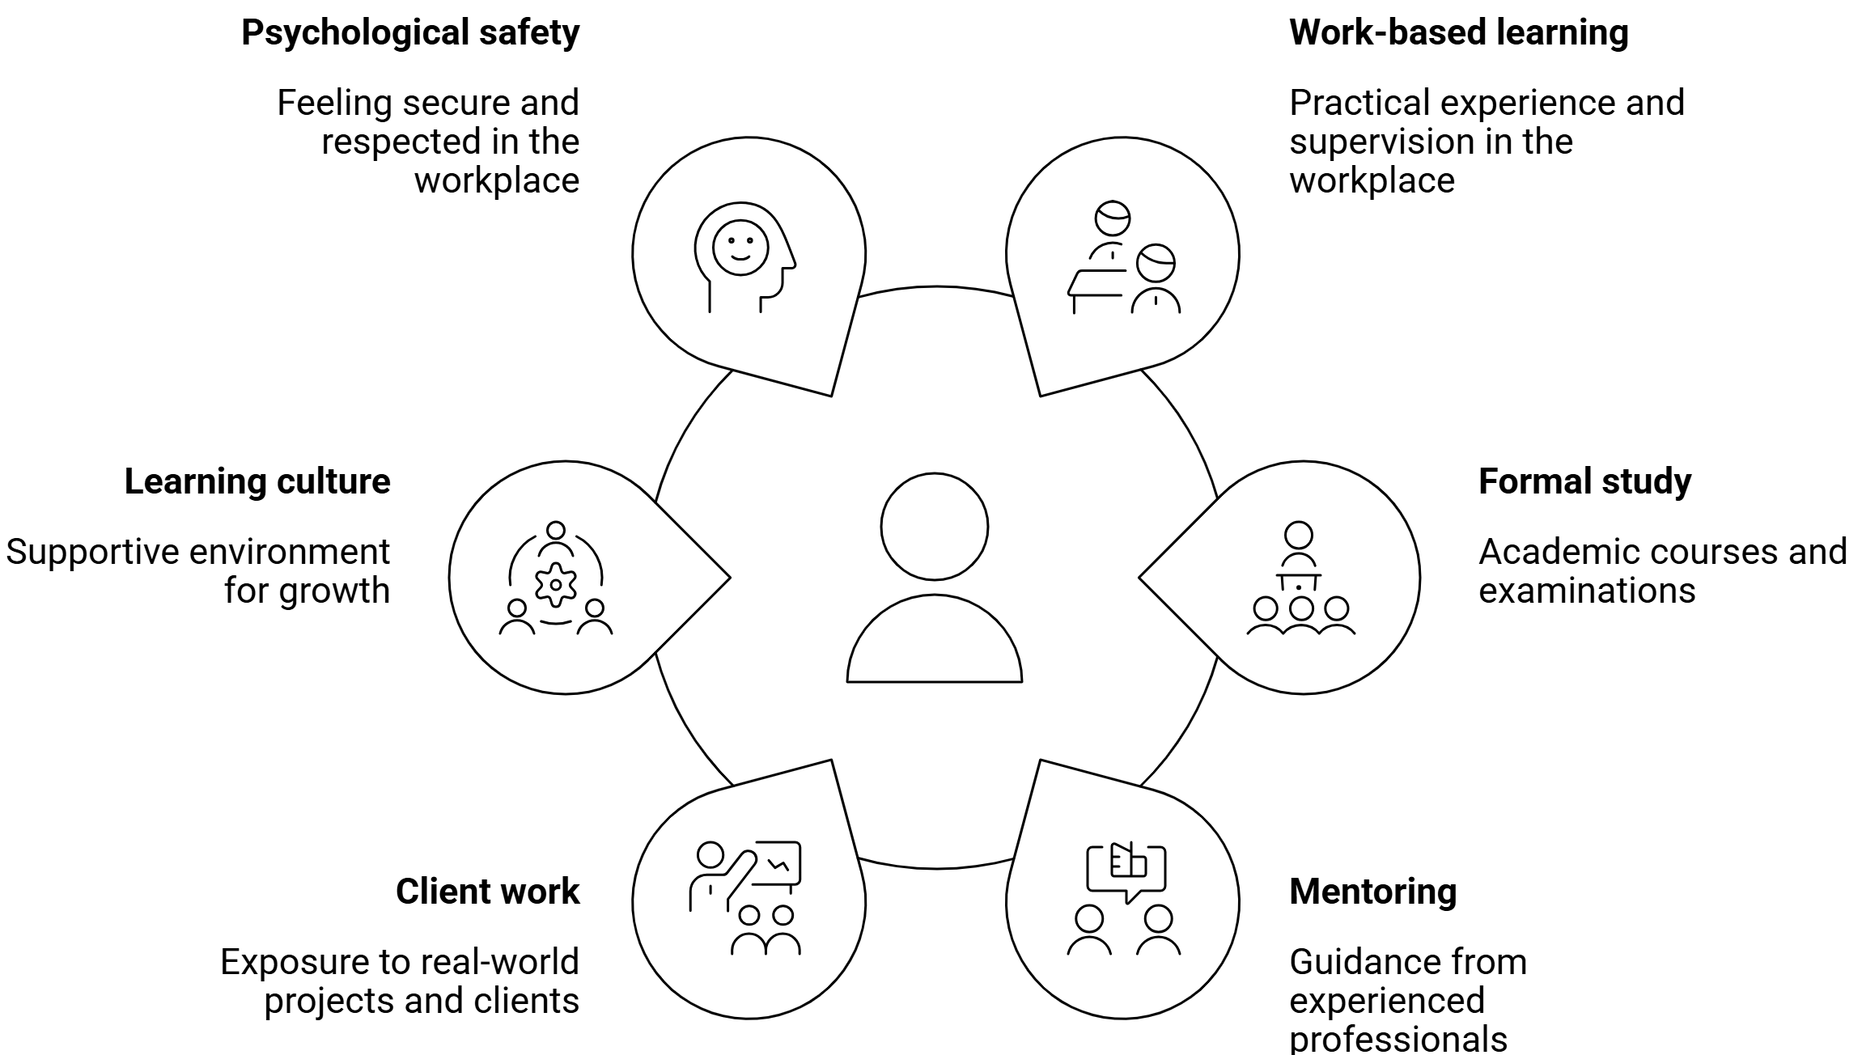
LEARNING AND DEVELOPMENT CULTURES AND THE INTEGRATION OF EXPERIENCE, LEARNING AND ASSESSMENT
Elements contributing to professional learning and development
Required flexibility
To reflect and meet the needs of different settings, sectors and specialties, and of different employers and consumer.
Unwarranted variation
Differences in access to learning opportunities and support, potentially impacting on learning outcomes.

Slide 13
LEARNING AND DEVELOPMENT CULTURES AND THE INTEGRATION OF EXPERIENCE, LEARNING AND ASSESSMENT
Strengthened integration and workplace learning cultures
01
02
03
04
Clearer core requirements
Use of individual training plans and logs
Structured supervision
Stronger connections between all learning and assessment
05
06
07
Access to mentoring support
Foundational, authentic learning opportunities
Support for breadth and depth of learning
Supportive learning cultures that provide effective support for trainees’ professional formation and competence acquisition
Proportionality caveat: avoid undue burden on any one party; build on existing foundations

Slide 14
LEARNING AND DEVELOPMENT CULTURES AND THE INTEGRATION OF EXPERIENCE, LEARNING AND ASSESSMENT
Assessment must remain rigorous and reflect contemporary practice needs
Maintain rigour
A consistent priority
No single model
Test contemporary competence requirements in authentic ways
Balanced
assessment
Approaches working
together
The evidence did not establish one preferred future approach
Some questioned examinations alone
Apply safeguards
Explore alternatives
Fair, proportionate and robust
Interest in holistic and workplace-based approaches

Slide 15
WHAT YOU TOLD US ABOUT WIDENING ENTRY TO THE PROFESSIONS
Widen access while maintaining standards
The emphasis was on removing unnecessary barriers, not lowering competence requirements
Awareness
Cost
Circumstances
Accessibility
Low visibility of the professions
Fees and financial pressure
Caring responsibilities
Disability and neurodivergence
Geography
Culture
Flexibility
Recruitment
Location and travel constraints
Belonging and workplace practices
Training and assessment formats
Traditional routes and perceptions of fit
“Widening access” and “maintaining standards” generally seen as compatible

Slide 16
WHAT WE HEARD ABOUT THE TRADE MARK ATTORNEY PROFESSION
Trade mark attorney-specific messages
Existing foundations
Changing practice
Broad support for the current competence framework.
Commercial and multidisciplinary practice; online brand protection; enforcement; clearance and risk assessment; related fields.
Client and commercial context
Qualification route
Tailored advice; commercial objectives; strategic rather than purely technical advice.
General preference to retain the university-based route.

Slide 17
THREE CONNECTED REGULATORY LEVERS
Our intended Review outputs
With a focus on being inclusive, flexible and non-prescriptive.
1
2
3
Updated competence frameworks
Updated accreditation standards
Updated QAE method
What must individuals know and be able to do?
What must providers demonstrate?
How will IPReg gain assurance?
requirements → application → assurance
These are the resources we will consult on in early 2027.

Slide 18
IPReg Education Review roadmap
KEY MESSAGES AND NEXT STEPS
WE ARE HERE
Oct 2024
Oct 2025
May 2026 –
Dec 2026
May 2027 –
Sep 2027
From May 2028
Initial scoping of review
Formation of Expert Advisory Group and Reference Group
Analysis of response to Call and drafting of outline proposals
Finalisation of Review outputs
Full implementation and ongoing evaluation
April 2025
Feb 2026 –
Apr 2026
Jan 2027 –
Apr 2027
Oct 2027 –
Apr 2028
Education Review ‘soft launch’
Call for Evidence and Feedback
Public consultation on draft proposals
Transition, early implementation and evaluation
Share your views
Have your say!
Please note these are indicative timeframes and subject to change

Slide 19
How we are using Call responses
KEY MESSAGES AND NEXT STEPS
Independent equality impact assessments
Seek LSB approval
for proposals
Analyse responses and identify key issues and themes
1
Share reports on the analysis in full and summary formats
2
Use the analysis to inform the Review proposals
3
Share the proposals via formal consultation
4
Refine the proposals post-consultation
5
Define formal timeframe to implement Review outputs
7
Begin implement-ing Review outputs
8
Collaborate with stakeholder to inform timeframes for changes
6
WE ARE HERE

Slide 20
STAY IN TOUCH
How to contact us
IPReg Education Review team
edreview@ipreg.org.uk
Questions about the Review or interested in joining the Reference Group? Email us.
To express interest in the Reference Group, please use the email subject “Education Review Reference Group”.
See our website:
Call findings report
FAQs on the Review
Sign up to receive our Review newsletter
Follow us on LinkedIn
22

Slide 21
KEY MESSAGES AND NEXT STEPS
Closing messages
Building on strong foundations
  Updating requirements for changing practice, including AI, while building on existing good practice.
Strengthening learning and support
  Valuing workplace learning and exploring proportionate ways to recognise it within qualification routes.
Widening access while maintaining standards
  Removing unnecessary barriers to entry and to progression.
Ensuring proportionality
  Any proposed reforms need to be justified, purposeful and realistic.
Using the Call findings to develop proposals
  Consulting on proposals and draft outputs early in 2027. IPReg has not yet made decisions on future changes.
23

